Slide 1

Super-Flat Beam Generation
with Emittance Exchange Technique
for Linear Colliders
16th High Brightness and RF Electron Gun Workshop
Masao KURIKI
Graduate School of Advanced Sciences of Matter,
Hiroshima University
ALLPPT.com _ Free PowerPoint Templates, Diagrams and Charts

Slide 2
Contents
Introduction,
Emittance Exchange,
Super-flat beam generation for linear colliders,
Summary

Slide 3
Introduction
Emittance is defined as the volume in 6D phase-space.
The 6D emittance is invariant (Loisville's theorem).
2D emittance is not invariant, even with a linear optical element.
That leads that 2D emittances (x, y, z) can are operable.
z
px
pz
py
ｘ
ｙ
ｘ
px

Slide 4
XY-Z Emittance Exchange
TLEX
(Transverse to Longitudinal Emittance eXchange)

Slide 5
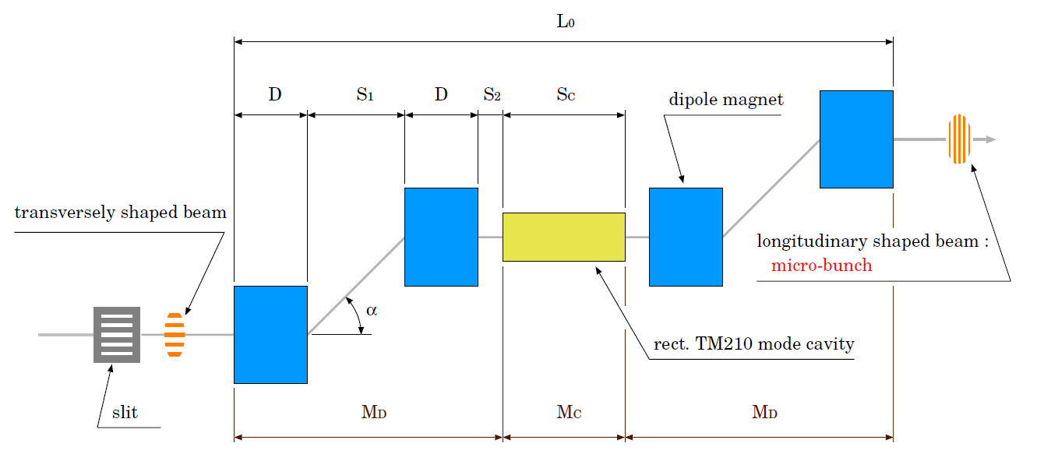
TLEX
TLEX can be made with chicane or two doglegs and a dipole mode RF cavity.
The phase spaces of X(transverse direction in deflecting plane) and Z (longitudinal direction) are swapped.

Slide 6
Transfer Matrices
One dog-leg section
Dispersion
Momentum compaction
Effective length
TM₀₁₁cavity

Slide 7
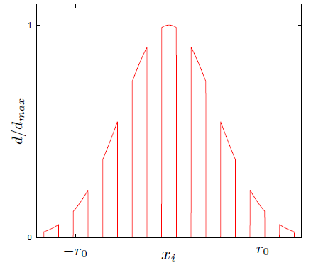
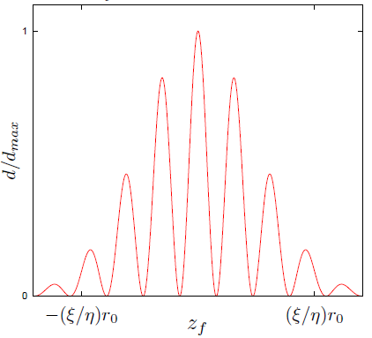
EEX Matrix
x0
matching condition
z1
compression
factor
dilution
factor
x-z space exchange
by the 4D space rotation.
otsuki

Slide 8
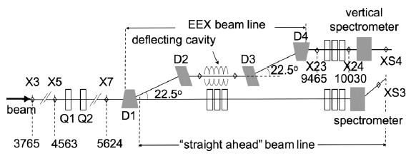
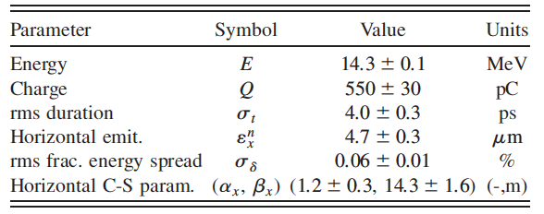
Tunable Subpicosecond Electron-Bunch-Train Generation Using a Transverse-To-Longitudinal Phase-Space Exchange Technique
Y.-E Sun, et al.,
PRL(105)2340801(2010)

Slide 9
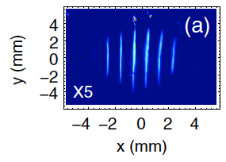
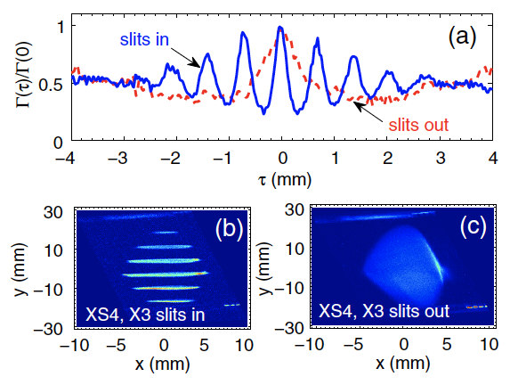
Primary modulation
(slits in x)
After Z-X rotation
(y corresponds to z)
RMS<300fs
(limited by resolution)

Slide 10
XY Emittance Exchange
RFTB(Round to Flat Beam Transformation)

Slide 11
Magnetized Beam
Vector Potential
Beam Generation in solenoid makes the Canonical angular momentum by Vector potential.
By the fringe field, the canonical momentum becomes the kinetic momentum .
The x-py and y-px correlated beam is obtained.
Magnetized Beam
In sigma matrix

Slide 12
Restoration Matrix
By ignoring the intrinsic
emittance, the beam at
the exit of the solenoid
field are correlated in x
and y.
If the condition is
satisfied, Y1 is
independent from X0.
The correlation is
restored.
E. Thrane, LINAC2002

Slide 13
How to restore?
Sigma matrix at the downstream of solenoid field has the non-diagonal components.
The non-diagonal component is vanished by M if the correlation is removed by the transfer.

Slide 14
M matrix
Let us assume three skew Qs
Assume
To satisfy

Slide 15

Restoration Matrix
After skew Q channel,
$$ε_{n}^{±}=\sqrt{{ε_{n}^{u}}^{2}+{\left(γβL\right)}^{2}}$$
E. Thrane, LINAC2002

Slide 16
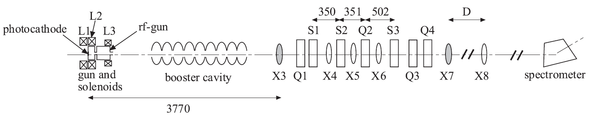
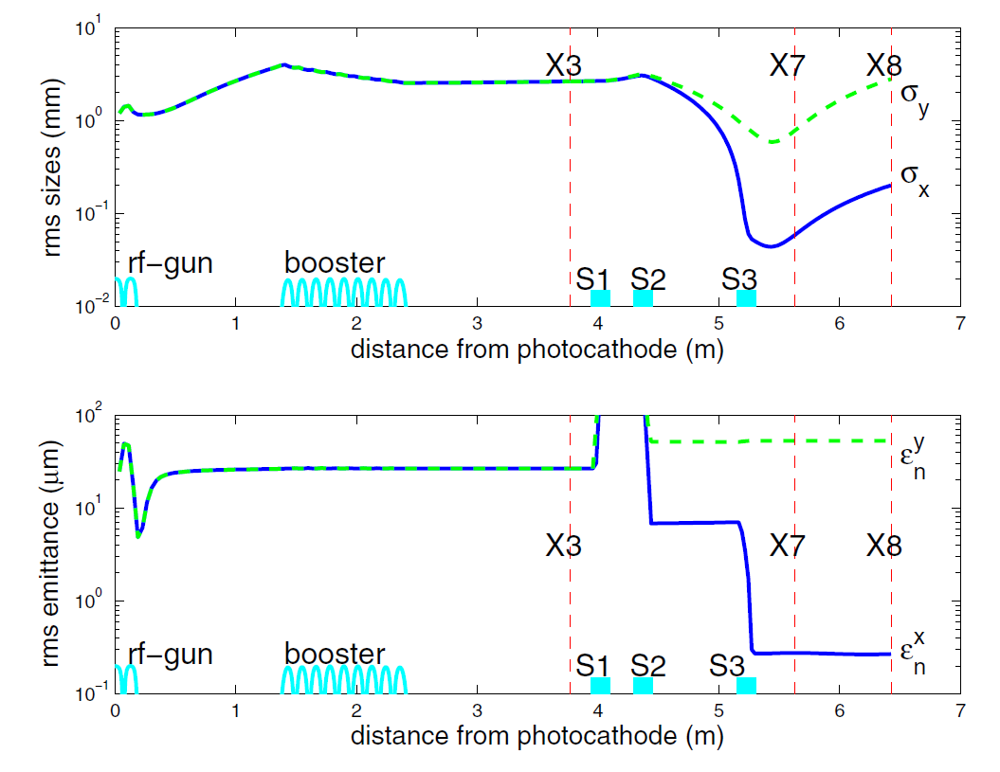
P.Piot, Y.-E Sun, K.-J. Kim
PRSTAB(9)031001(2006)
Emittance Ratio 100
was achieved.

Slide 17
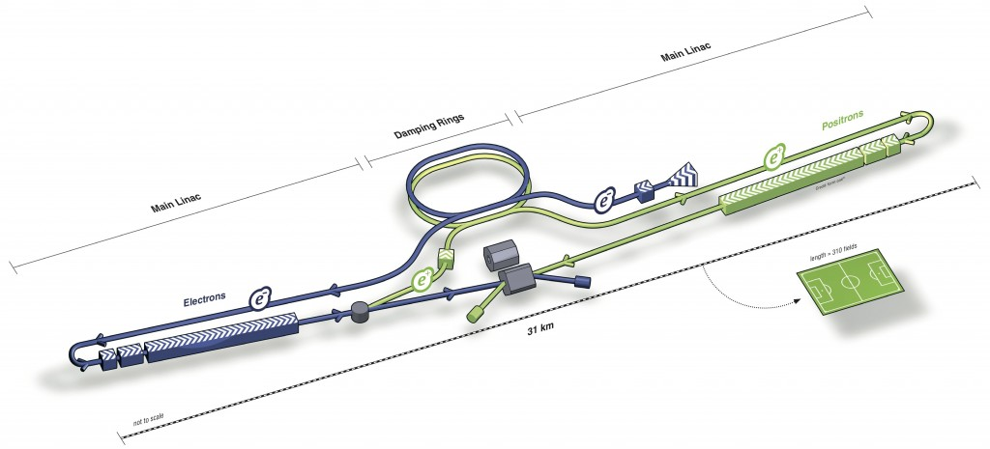
Asymmetric Beam for Linear Collider
Linear Collider is an only solution for e+e- collision beyond the limit of ring colliders due to the huge energy loss by synchrotron radiation.
The beam is “one pass” and the beam current is very limited for linear collider.
To obtain an enough luminosity, the beam is focused down to nm.

Slide 18



Luminosity Optimization
Luminosity
Energy Spread by Beamstrahlung
Large luminosity and
suppressed BS is
obtained with
$$ℒ=\frac{fn_{b}N^{2}}{4πσ_{x}σ_{y}}$$
$$δ_{E}=\left\langle −\frac{ΔE}{E}\right\rangle \sim 0.209\frac{N^{2}{r_{e}}^{3}γ}{σ_{z}}{\left(\frac{2}{σ_{x}+σ_{y}}\right)}^{2}U_{1}\left(Υ\right)$$
Parameter | Value
Horizontal size | 640 nm
Vertical size | 5.7 nm
Bunch length | 300 μm
Vertical Disruption | 19.4
RMS energy by BS | 2.4%
Horizontal emi. | 10 mm.mrad
Vertical emi. | 0.04 mm.mrad
$$1≫σ_{x}≫σ_{y}$$
18
Notes:
18

Slide 19
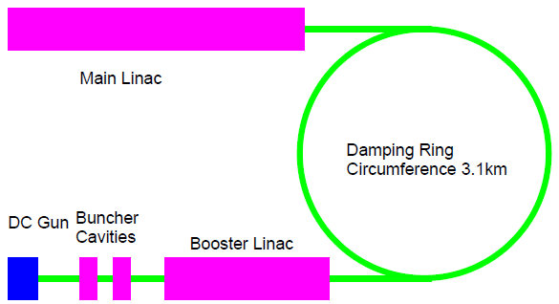
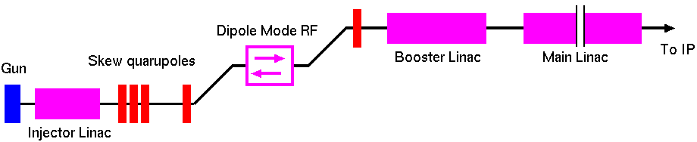
High Aspect Ratio Beam by EMIX
The high aspect ratio beam is generated by a 3km DR (Damping Ring) in the current design (ILC TDR).
I the beam can be generated directly from the injector with EmiX technique, the design can be much simpler.

Slide 20
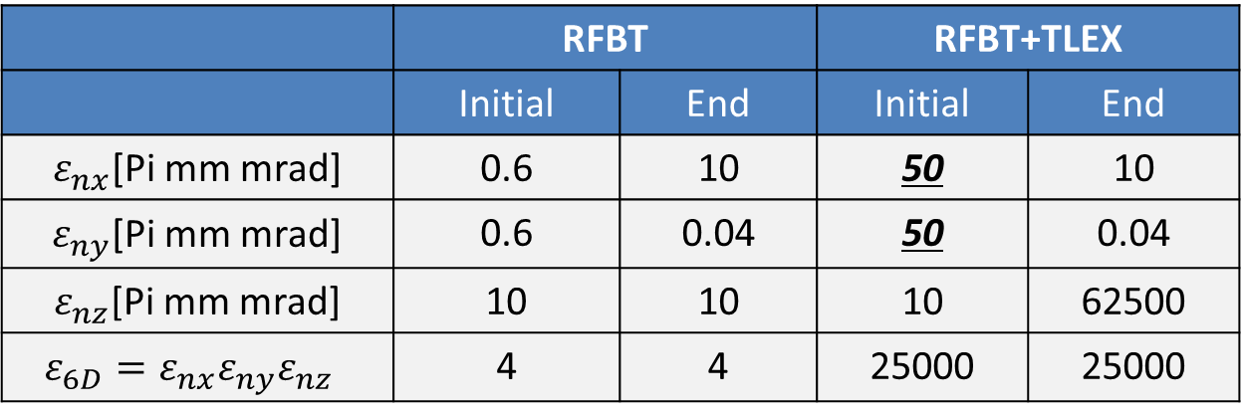
Emittance Budget
The flat beam for LC (ε_{x}=10μm, ε_{y}=0.04μm) might be generated with RFBT (xy rotation). In that case, the initial emittance is ε_{x}=ε_{y}=0.6μm.
In this case, a strong non-linear space charge with 4.8nC bunch charge is concerned.
To solve this issue, RFBT + TLEX are considered.
In this case, the beam is generated in a large spot size and converted to LC compatible beam with a large ε_{z}.
 | RFBT |  | RFBT+TLEX
 | Initial | End | Initial | End
$ε_{nx}$[Pi mm mrad] | 0.6 | 10 | 50 | 10
$ε_{ny}$[Pi mm mrad] | 0.6 | 0.04 | 50 | 0.04
$ε_{nz}$[Pi mm mrad] | 10 | 10 | 10 | 62500
$$ε_{6D}=ε_{nx}ε_{ny}ε_{nz}$$ | 4 | 4 | 25000 | 25000

Slide 21
The Beam Line
B field
Skew Quadrupoles
laser
Injector Linac
Polarized Beam
GaAs/GaAsP
Super-lattice
Dipole Mode
RF cavity
Dogleg
To booster
Dogleg

Slide 22
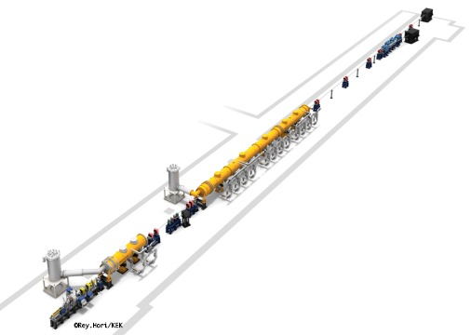
Beam Test at STF-KEK
STF（Superconducting Test Facility) at KEK
Test facility for Superconducting Accelerator.
L-band RF electron gun
14 L-band Superconducting accelerators.
RFBT+TLEX demonstration
Putting skew Q channel for RFBT demonstration. A solenoid field on cathode can be implemented by inverse the bucking coil polarity.
Implementation and demonstration of TLEX is a future project.

Slide 23
RFBT Demonstration at STF
SkewQ channel
Qscan section
×2
×12
Gun
SCL
Q1
Q2
Q3
Q5
Q6
SCL
Q9
Q12
skew1
skew2
skew3
Q17
Q18
OTR
Q13
Q16
Newly installed
SkewQ×3 and Q×2 are newly installed in the existing STF beam line.
Demonstration of an asymmetric emittance beam generation with RFBT and the measurement.
A simulation study was made.

Slide 24
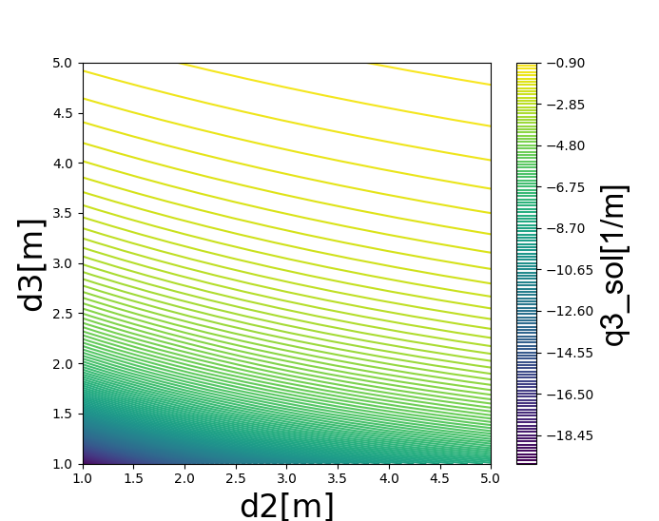
SkewQ channel
skewQ
1
d₂
SkewQ
2
d₃
SkewQ
3
RFBT employs 3 skew Q magnets.
Chromaticity of the skew Q is one of the source of emittance growth.
To suppress the chromaticity, amplitude should be low.
Distance of skew Q magnets should be 3 m or more.

Slide 25
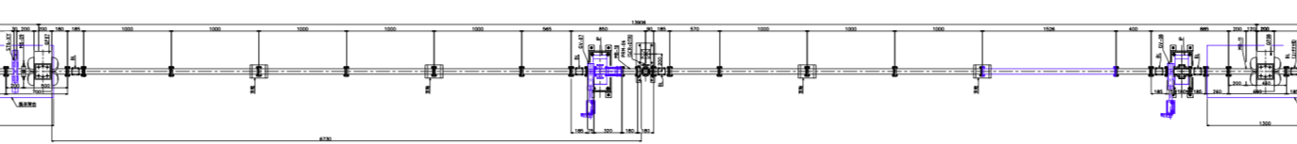
Skew Q channel and Qscan section
1m
1m
0.7m
Q12
PRM-06
SCR+OTR
Q13
skew1
skew2
skew3
Q
Q
OTR
BL
3.000m
3.486m
5.394m

Slide 26
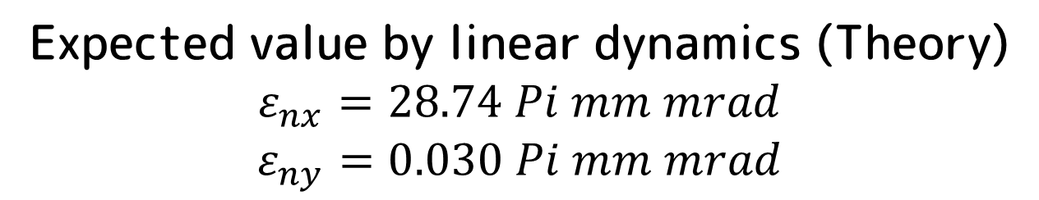
Parameters
Parameter | Value | Unit
Initial emittance ε_{nx,ny} | 0.81 | Pi mm mrad
Solenoid field B_{C} | 〜800 | Gauss
Bunch length σ_{z} | 3 | ps
Initial Beam size σ_{x,y} | 0.8 | mm
Initial beam energy E_{kin} | 0.75 | eV
Bunch charge | 0.5 | nC
Expected value by linear dynamics (Theory)
$$ε_{nx}=28.74 Pi mm mrad$$
$$ε_{ny}=0.030 Pi mm mrad$$

Slide 27
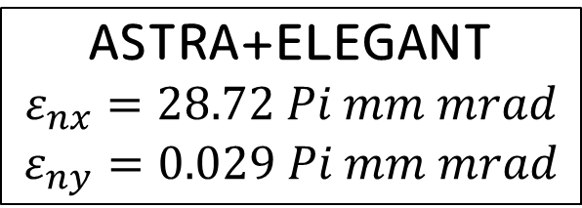
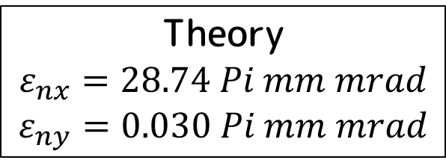
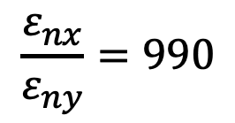
Result (No space charge)
Theory
$$ε_{nx}=28.74 Pi mm mrad$$
$$ε_{ny}=0.030 Pi mm mrad$$
sk1
ASTRA+ELEGANT
$$ε_{nx}=28.72 Pi mm mrad$$
$$ε_{ny}=0.029 Pi mm mrad$$
sk2
$$\frac{ε_{nx}}{ε_{ny}}=990$$
sk3
※including Chromaticity
Close to that by linear dynamics

Slide 28
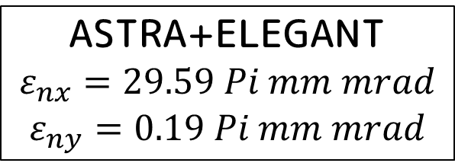
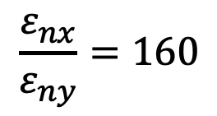
Result (With Space Charge)
Theory
$$ε_{nx}=28.74 Pi mm mrad$$
$$ε_{ny}=0.030 Pi mm mrad$$
ASTRA+ELEGANT
$$ε_{nx}=29.59 Pi mm mrad$$
$$ε_{ny}=0.19 Pi mm mrad$$
$$\frac{ε_{nx}}{ε_{ny}}=160$$
ε_{ny} is six times larger.
Space charge in near of cathode is the reason.
Further suppression should be made.

Slide 29
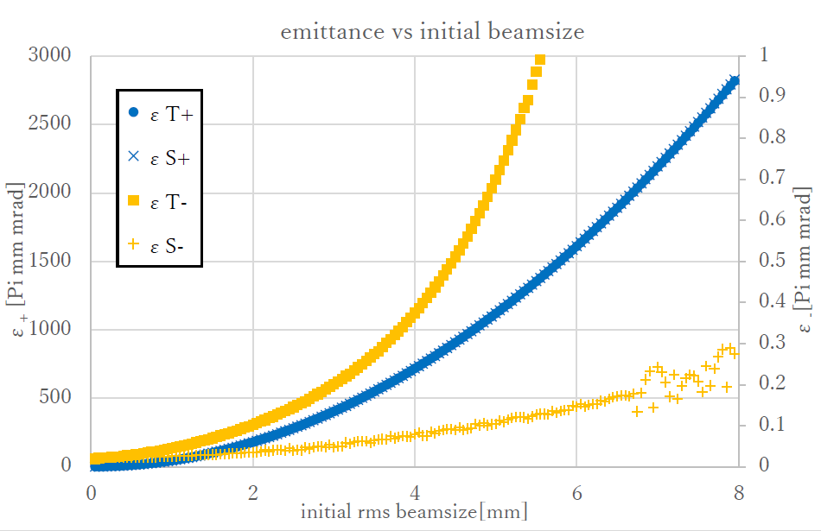
Larger Beam Spot
No space cahrge
Tracking
Theoretical
ε- by tracking is grown comparing to ε- by theory.
The reason is not understood yet.
Geometrical aberration ?

Slide 30
Summary
RFBT and TLEX realize manipulation of among emittances of different axe.
Linear collider requires small emittance beam in x and y with a large asymmetry.
Instead of radiation damping with DR, RFBT and TLEX could make the beam.
Emittance growth with a larger beam size should be understood.
Demonstration of RFBT will be made in STF.
Full demonstration of RFBT + TLEX is possible if we add TLEX at the downstream.

Slide 31
Robust Spin Polarized Electron Source
A stable NEA (Negative Electron Affinity) surface on GaAs for a robust spin polarized electron source.
The robust spin polarized electron extend the operability of the beam parameter greatly at the electron source.
According to the hetero-junction model, a stable thin-film on GaAs with a condition make the robust NEA cathode : E_{BG} – φ >0.
Candidates are CsTe, CsKTe, etc.
NEA activation (electron emission at E_{BG} photon energy) was observed with CsTe and CsKTe thin films.
p-type GaAs
Activation with CsKTe : Te 14 Å
Thin
film
vacuum
Conduction Band
NEA
E_{BG}~1.4eV
E_{BG}
Φ
Fermi
level
Valnece Band
K. Masaki

Slide 32
Acknowledgement
P. Piot (Northern Illinois University),
J. Power (ANL),
H. Hayano, N. Yamamoto, Y. Seimiya (KEK),
S. Kashiwagi (Tohoku University),
K. Sakaue(U of Tokyo),
M. Wahio (Waseda University),
R. Tamura, T. Nishimura, K. Masaki(Hiroshima U.)
This work is partly supported by Japan-US
Cooperative grant for scientific studies,
Grant aid for scientific study by
MEXT Japan (KAKENHI)

Slide 33
RFBT simulation : Beam size
Coupling emittance [mm.mrad]
Beam size dependence was studied with ASTRA.
At the larger beam size, the emittance ratio becomes much smaller than that expected with a proper rotation (theoretical).
The coupling emittance is large at the large beam size.
It shows that a more fine adjustment is needed at the large beam size to obtain the high emittance ratio.
R. Tamura

Slide 34
RFBT simulation : Solenoid field
No space charge
With space charge
RFBT simulation (xy emittance exchange) was performed with ELEGANT.
With a proper rotation, the coupling emittance becomes negligibly small.
No space charge: Emittance exchange is successfully done.
With space charge: Emittance exchange is sometimes failed (finite coupling emittance.)
Emittance ratio is saturated at high solenoid field. Need investigation.
R. Tamura

Slide 35
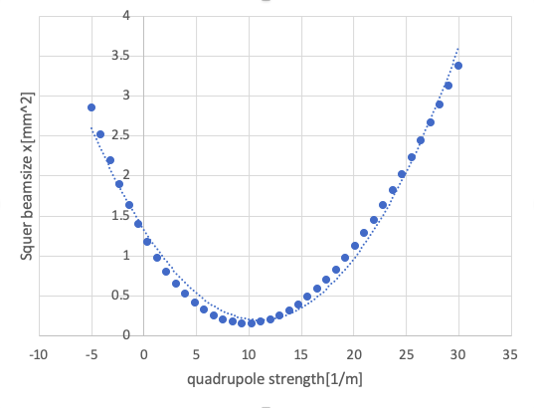
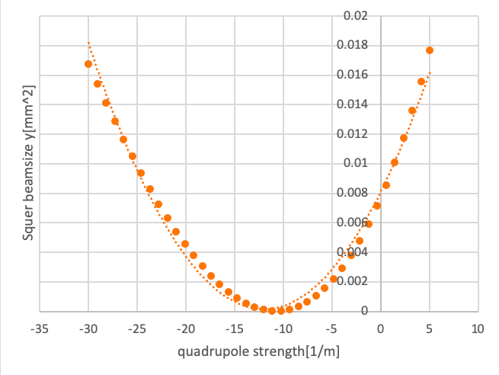
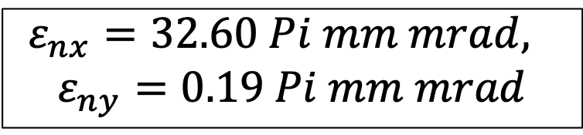
Emittance Measurement by Q-scan
X
Y
$$ε_{nx}=32.60 Pi mm mrad,$$
$$ε_{ny}=0.19 Pi mm mrad$$
Emittance by Q-scan
（RMS）
Emittance evaluated
from distribution（RMS)
ε_{nx}=29.59 Pi mm mrad,
ε_{ny}=0.19 Pi mm mrad
Spatial resolution by OTR is not included.

