Slide 1
Coherent φ-meson photo-production from helium-4 near threshold with linearly polarized photons
Toshihiko Hiraiwa
for the LEPS Collaboration
RCNP, Osaka University
(ELPH, Tohoku University)
Outline
Introduction
LEPS/SPring-8
Data analysis
Result and discussion
Summary

Slide 2
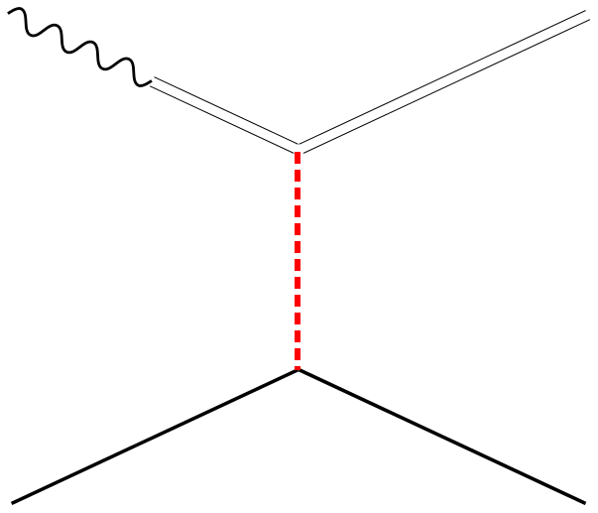
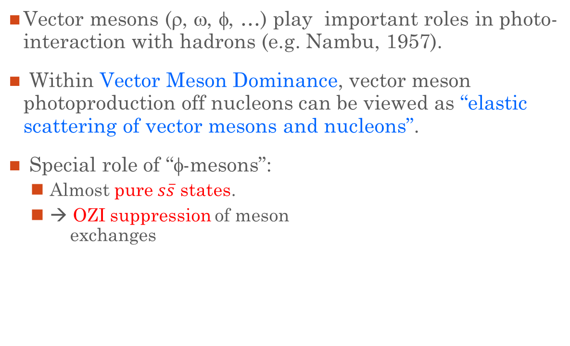
φ-meson photoproduction
Vector mesons (ρ, ω, φ, …) play important roles in photo-interaction with hadrons (e.g. Nambu, 1957).
Within Vector Meson Dominance, vector meson photoproduction off nucleons can be viewed as “elastic scattering of vector mesons and nucleons”.
Special role of “φ-mesons”:
  Almost pure $s\overline{s}$ states.
  → OZI suppression of meson
  exchanges
γ (J^{PC}=1⁻⁻)
φ
φ (J^{PC}=1⁻⁻)
Pomeron,
multi-gluons,
…
A good probe to study gluonic interactions such as Pomeron and multi-gluon exchances
at low energies!!
N
N

Slide 3
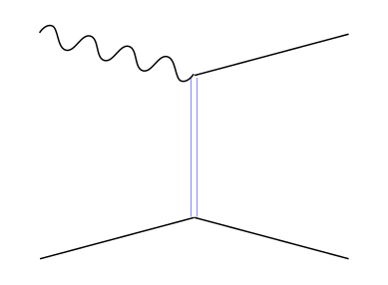
Coherent φ-meson photoproduction from ⁴He
γ
φ
Thanks to the target quantum numbers (J^{P} = 0⁺), Pomeron and multi-gluon exchanges are “much enhanced”.
Because the couplings of unnatural-parity particles to ⁴He are forbidden due to “spin-parity conservation”.
Unnatural-parity particles [P = -(-1)^{J}]
(π, η, …)
⁴He
Due to spin-parity conservation
⁴He
This reaction provides an “ideal laboratory” for investigating Pomeron and multi-gluon exchanges at low energies!!

Slide 4
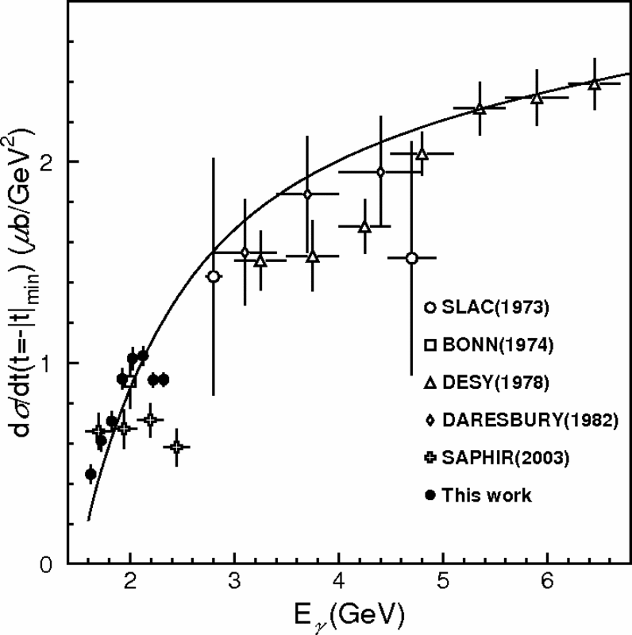
Forward “bump” in φ-photo-production off protons
Pomeron+(π, η) exchanges
First reported by LEPS.
[PRL95(2005)182001]
Confirmed by CLAS with high-statistics data.
[PRC89(2014)055208]
Its origin is NOT understood due to a “large ambiguity” in modeling Pomeron exchange at low energies.
⇒ Need to determine the Pomeron contribution near threshold experimentally.
← Motivation of the present
measurement!!
LEPS(2005)
PRL95 (2005) 182001.

Slide 5
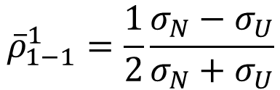
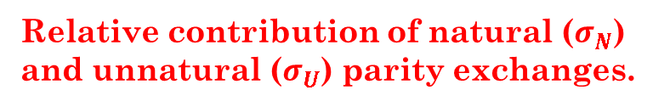
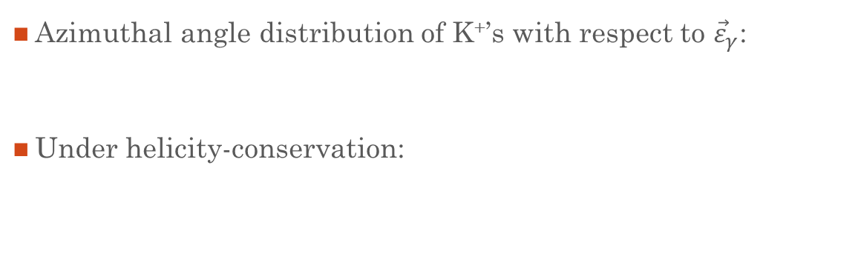
Decay angular distribution with linearly polarized photons
@ Gottfried-Jackson frame
Azimuthal angle distribution of K⁺’s with respect to ${\vec{ε}}_{γ}$:
Under helicity-conservation:
$$W\left(Φ−Ψ\right)∝1+2P_{γ}{\overline{ρ}}_{1−1}^{1}\cos{2\left(Φ−Ψ\right)}$$
Called a “decay asymmetry”
$${\overline{ρ}}_{1−1}^{1}=\frac{1}{2}\frac{σ_{N}−σ_{U}}{σ_{N}+σ_{U}}$$
Relative contribution of natural ($σ_{N}$) and unnatural ($σ_{U}$) parity exchanges.

Slide 6






Decay asymmetry ${\overline{ρ}}_{1−1}^{1}$ for γp → φp
Bump region
Pomeron+(π, η)
($t=−{\left|t\right|}_{min}$)
LEPS (2005)
($\left|t\right|−{\left|t\right|}_{min}≤0.2$ GeV⁻²)
$${\overline{ρ}}_{1−1}^{1}$$
LEPS (2010)
($\left|t\right|−{\left|t\right|}_{min}≤0.05$ GeV⁻²)
LEPS (2018)
($\left|t\right|−{\left|t\right|}_{min}≤0.05$ GeV⁻²)
Photon energy (GeV)
A sizable 20–30% contribution of unnatural-parity exchanges.
A general trend of the data is consistent with that of a Pomeron+(π, η) exchange model.

Slide 7
LEPS/SPring-8 facility
“High linearly-polarized” photons are produced via backward Compton scattering between laser photons and circulating electrons in storage ring.
Energy range: E_{γ} = 1.5 – 2.4 GeV
Charged particles are detected at forward angles by LEPS spectrometer.
LEPS spectrometer consists of:
  Trigger counters (UPveto, STA),
  AC counter (for e⁺e⁻ veto).,
  Four MWDCs,
  Dipole magnet (0.7 T).
Typical momentum resolution:
δp/p ~ 0.9% for p = 1 GeV/c.
K⁺
Target
K–
γ beam

Slide 8
Identification of coherently-produced φ-mesons via φ → K⁺K⁻ decay
Invariant mass of K⁺K⁻
Missing mass of ⁴He(γ, φ)X
Production of φ-mesons was identified by M(K⁺K⁻).
Total-φ yields were evaluated by fits to M(K⁺K⁻) spectra with two MC templates:
  φ-production, followed by φ → K⁺K⁻ decay (signal)
  Non-resonant K⁺K⁻ production (BG)
Coherent events were disentangled from incoherent ones by ΜM(K⁺K⁻).
#’s of coherent φ’s were evaluated by fits to MM(K⁺K⁻) spectra with two MC templates:
  Coherent production events (signal)
  Incoherent production events (BG)

Slide 9
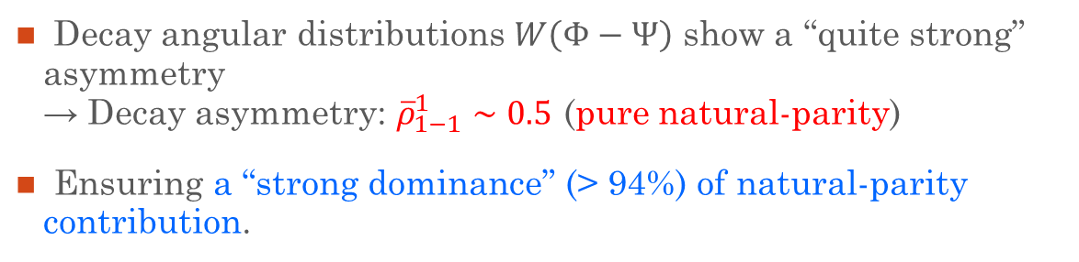

Decay asymmetry of coherent γ⁴He reaction
@ $\left|t\right|−{\left|t\right|}_{min}≤0.2$ GeV²
1.985 < E_{γ} < 2.185 GeV
2.185 < E_{γ} < 2.385 GeV
Decay angular distributions $W\left(Φ−Ψ\right)$ show a “quite strong” asymmetry
→ Decay asymmetry: ${\overline{ρ}}_{1−1}^{1}∼0.5$ (pure natural-parity)
Ensuring a “strong dominance” (> 94%) of natural-parity contribution.

Slide 10
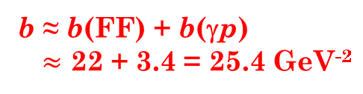
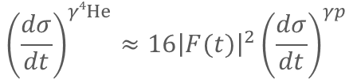
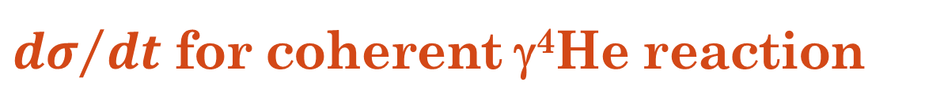
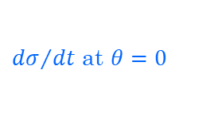
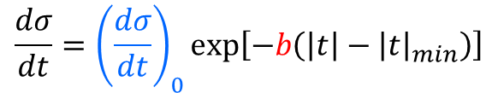
${dσ}/{dt}$ for coherent γ⁴He reaction
Slope b shows no significant energy dependence.
Common slope b:
b = 23.81±0.95 GeV⁻²
Consistent with a “single-scattering assumption”.
$${\left(\frac{dσ}{dt}\right)}^{γ4He}≈16{\left|F(t)\right|}^{2}{\left(\frac{dσ}{dt}\right)}^{γp}$$
$$\frac{dσ}{dt}={\left(\frac{dσ}{dt}\right)}_{0}exp⁡\left[−b\left(\left|t\right|−{\left|t\right|}_{min}\right)\right]$$
b ≈ b(FF) + b(γp)
$≈$ 22 + 3.4 = 25.4 GeV⁻²
Slope parameter
${dσ}/{dt}$ at $θ=0$

Slide 11
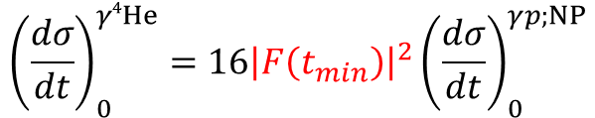
Energy dep of intercepts (dσ/dt)₀
γ + ⁴He → φ + ⁴He
cf.; γ + p → φ + p
LEPS (2005)
“pure” Pomeron
Old data
“pure” Pomeron
A different behavior from that of γp data reflects “the effect of the ⁴He form factor”.
$${\left(\frac{dσ}{dt}\right)}_{0}^{γ4He}=16{\left|F\left(t_{min}\right)\right|}^{2}{\left(\frac{dσ}{dt}\right)}_{0}^{γp;NP}$$
⁴He data
“Natural-parity” (NP) contribution
to γp data

Slide 12
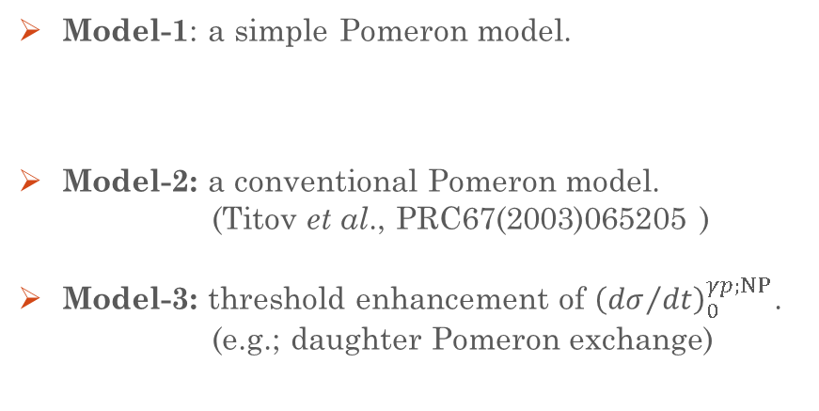
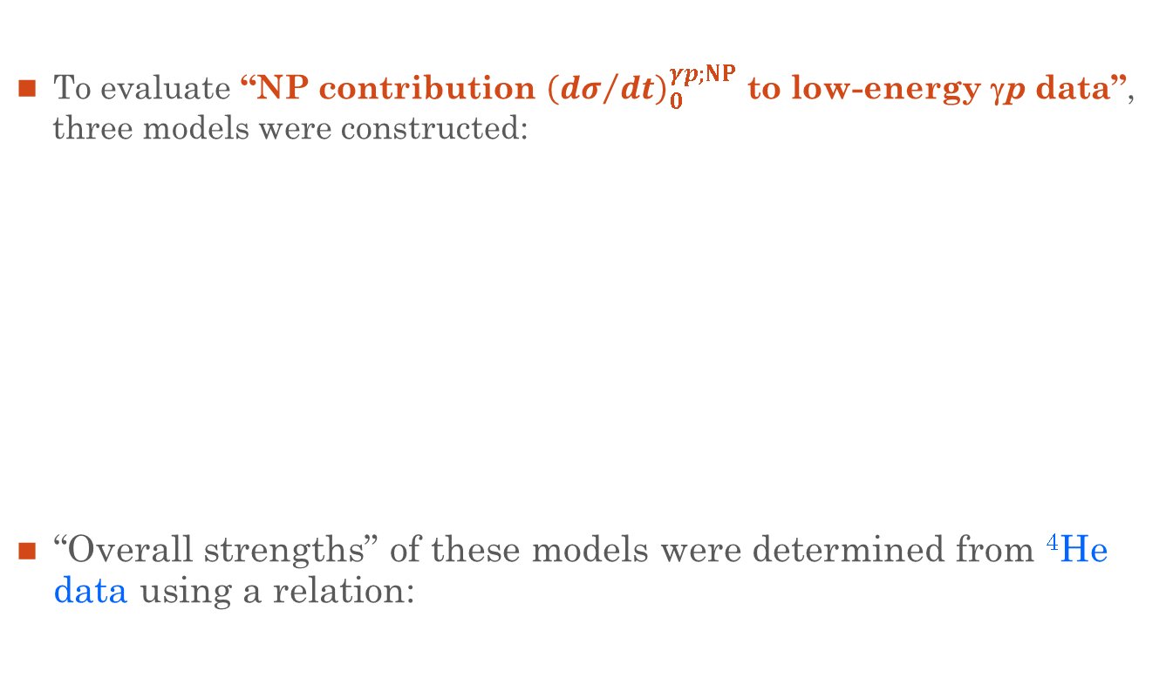


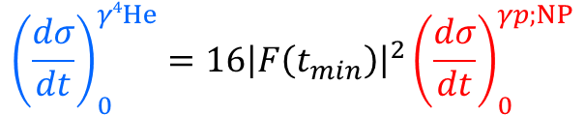
Models for natural-parity (NP) contribution to low-energy γp data
To evaluate “NP contribution ${\left({dσ}/{dt}\right)}_{0}^{γp;NP}$ to low-energy γp data”,
three models were constructed:
“Overall strengths” of these models were determined from ⁴He
data using a relation:
Model-1: a simple Pomeron model.
Model-2: a conventional Pomeron model.
(Titov et al., PRC67(2003)065205 )
Model-3: threshold enhancement of ${\left({dσ}/{dt}\right)}_{0}^{γp;NP}$.
(e.g.; daughter Pomeron exchange)
$${\left(\frac{dσ}{dt}\right)}_{0}^{γp;NP}∝{\left(\frac{p_{φ}}{p_{γ}}\right)}^{2}$$
($p_{γ}$, $p_{φ}$: CM momenta)
“Pure Pomeron”
Pomeron +
“additional NP”
$${\left(\frac{dσ}{dt}\right)}_{0}^{γ4He}=16{\left|F\left(t_{min}\right)\right|}^{2}{\left(\frac{dσ}{dt}\right)}_{0}^{γp;NP}$$
⁴He data
NP contribution to proton data

Slide 13
Fit to ⁴He data
γ + ⁴He → φ + ⁴He
χ²/ndf:
48.5/5 (model-1)
39.5/5 (model-2)
10.2/5 (model-3)
Based on the fit χ², model-3 is preferable.
But, all the models describe the data fairly well!
→ all the models are treated “eqaualy” hereafter.

Slide 14
NP contribution to low-energy γp data
γ + p → φ + p
Models-1 and 2 (Pure Pomeron):
  Slightly above the data for E_{γ} > 2.4 GeV.
  20–30% unnatural-parity (UP) contribution.
Model-3 (Pomeron + additional NP):
  Below the data for E_{γ} > 1.9 GeV by ~ 20%.
  ~ 20% of the UP contribution.
Destructive interference!!
No interference!!
“Destructive interference btwn Pomeron and UP exchanges” or/and “additional NP exchanges beyond Pomeron” are needed in γp reaction near threshold!!

Slide 15
Summary
The decay asymmetry and differential cross section for coherent φ-photoproduction from ⁴He were measured for the first time at forward angles near threshold.
The target quantum numbers (J^{P} = 0+) completely eliminate the unnatural-parity (UP) contribution.
The measurement of the decay asymmetry demonstrates a strong dominance (>94%) of natural-parity (NP) contribution.
Using the ⁴He cross section data, the NP contribution to low-energy γp data was evaluated through the models.
The comparison to available low-energy γp data suggests; “Destructive interference between Pomeron and UP exchanges” or/and “additional NP exchanges beyond Pomeron exchange” are needed in the γp reaction near threshold.
Thank you for your attention!

Slide 16
Backup

Slide 17
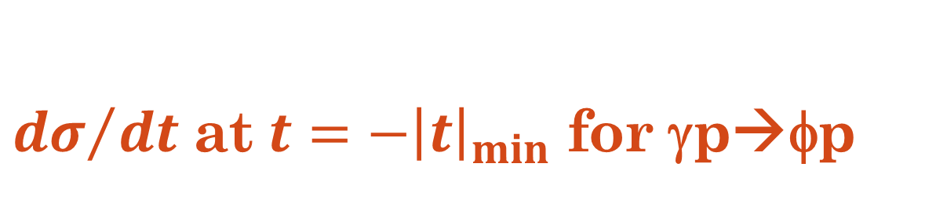
${dσ}/{dt}$ at $t=−{\left|t\right|}_{min}$ for γp→φp
w/ CLAS data
PRC89 (2014) 055208.

Slide 18
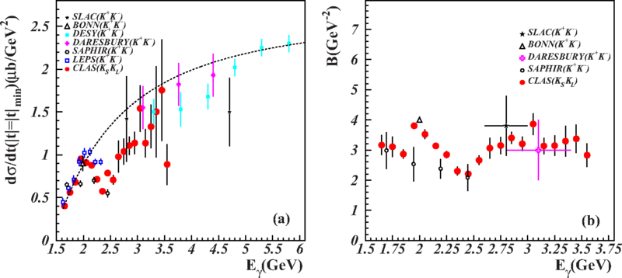
${dσ}/{dt}$ at $t=−{\left|t\right|}_{min}$ for γp→φp
w/ CLAS data
(neutral decay mode)
PRC89 (2014) 055206.

Slide 19
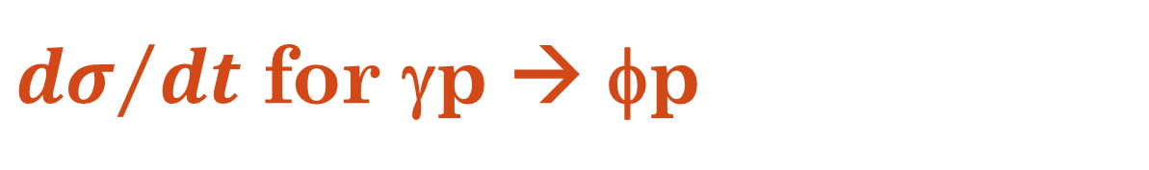
${dσ}/{dt}$ for γp → φp
Average slope: B = 3.57±0.12 (GeV⁻²)
Red: w/ fixed slope B
Green: w/ floating slope B
LEPS2018 data show a moderate energy dep. compared to other data.

Slide 20


Fermi motion in a ⁴He nucleus
Single proton
$tp$ cluster
$dd$ cluster
Taken from the numerical results of Variational Monte Calro (VMC) calculations [Wiringa et al., PRC89(2014)024305].
The magnitude of a Fermi motion was randomly determined event by event according to the VMC results.

Slide 21


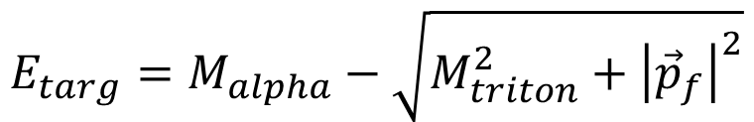

Off-shell correction
If the “on-shell mass” is assigned to nucleons with Fermi motion, the energy-conservation is obviously violated.
→ should be corrected!!
The energy of the target nucleon ($E_{targ}$) was calculated
as follows (“off-shell correction”):
$$E_{targ}=M_{alpha}−\sqrt{M_{triton}^{2}+{\left|{\vec{p}}_{f}\right|}^{2}}$$
proton
(target)
triton
⁴He mass
Triton energy
Proton energy
$${\vec{p}}_{f}$$
$${−\vec{p}}_{f}$$

Slide 22
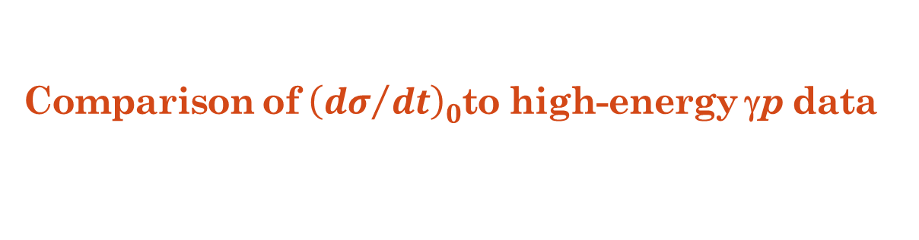


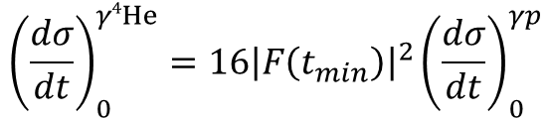
Comparison of ${\left({dσ}/{dt}\right)}_{0}^{}$to high-energy γp data
γ + ⁴He → φ + ⁴He
γ + p → φ + p
“pure Pomeron”
Compared to high-energy γp data through a “pure Pomeron” model:
Pomeron strength factor $C_{ℙ}^{2}$ (overall strength) was determined from γ⁴He data:
$${\left(\frac{dσ}{dt}\right)}_{0}^{γ4He}=16{\left|F\left(t_{min}\right)\right|}^{2}{\left(\frac{dσ}{dt}\right)}_{0}^{γp}$$
Modified DL Pomeron model by Titov
$$C_{ℙ}=(0.95±0.11)C_{ℙ}^{Titov}$$
Determined by Titov from high-energy ρ, ω, φ data

Slide 23
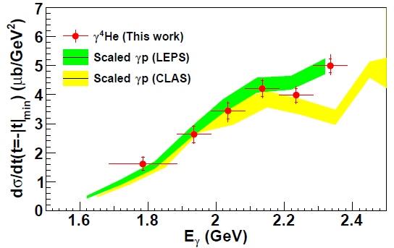
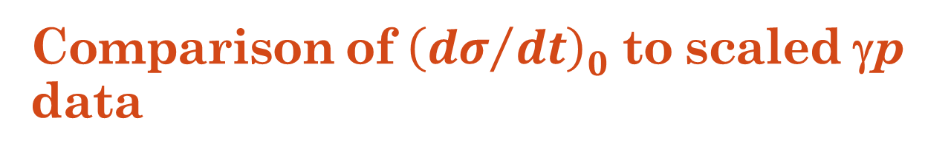
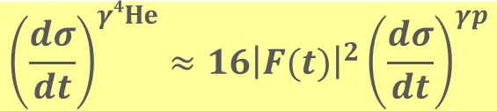
Comparison of ${\left({dσ}/{dt}\right)}_{0}^{}$ to scaled γp data
A similar structure
= a hint of the bump???
Proton data are scaled to ⁴He data through a relation:
by ignoring the π and η exchange contribution in proton data.
$${\left(\frac{dσ}{dt}\right)}^{γ4He}≈16{\left|F(t)\right|}^{2}{\left(\frac{dσ}{dt}\right)}^{γp}$$

Slide 24
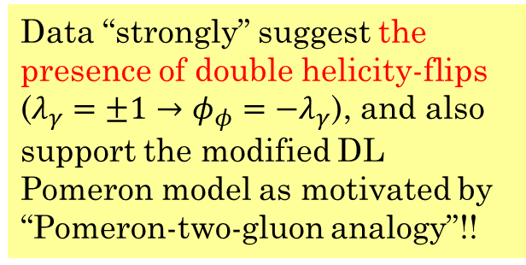

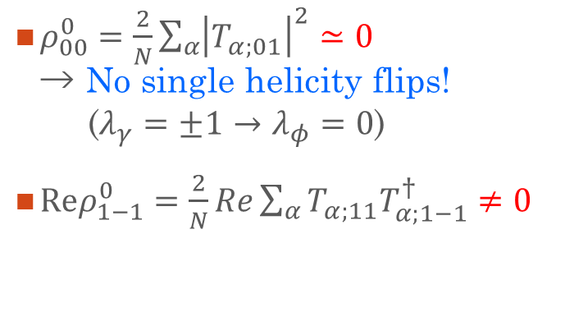



Helicity-flip process???
$ρ_{00}^{0}=\frac{2}{N}\sum_{α}{{\left|T_{α;01}\right|}^{2}}≃0$
→ No single helicity flips!
($λ_{γ}=±1→λ_{φ}=0$)
$Reρ_{1−1}^{0}=\frac{2}{N}Re\sum_{α}{T_{α;11}T_{α;1−1}^{†}}≠0$
$$ρ_{00}^{0}=−0.015±0.016$$
$$ρ_{00}^{0}=0.015±0.012$$
Data “strongly” suggest the presence of double helicity-flips ($λ_{γ}=±1→φ_{φ}=−λ_{γ}$), and also support the modified DL Pomeron model as motivated by “Pomeron-two-gluon analogy”!!
$${Reρ}_{1−1}^{0}=0.116±0.030$$
$${Reρ}_{1−1}^{0}=0.054±0.020$$

