Slide 1
Exact vector channel sum rules at finite temperature
Philipp Gubler, JAEA
P. Gubler and D. Satow, Phys. Rev D 94, 094042 (2016).
P. Gubler and D. Satow, Phys. Rev D 96, 114028 (2017).
Talk at the 8th International Conference on Quarks and Nuclear Physics (QNP2018)
Tsukuba, Japan
November 16, 2018

Slide 2
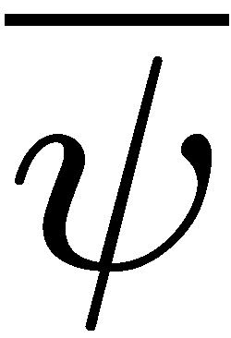
Introduction
Vector spectral function at finite T

Slide 3
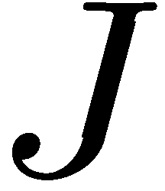
Introduction
Vector spectral function at finite T
Contains information on:
Electrical conductivity
Dilepton production rate
Vector meson spectrum at finite T

Slide 4
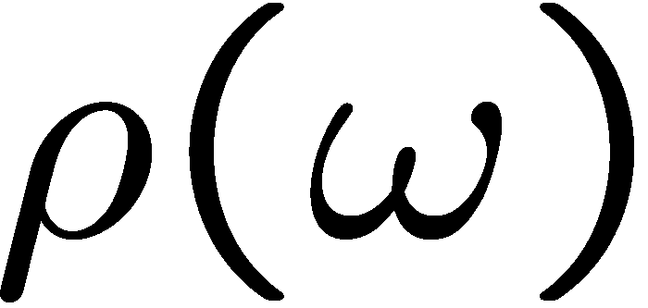
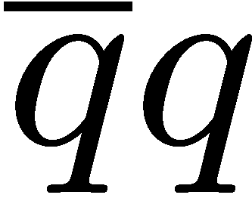
Introduction
Vector spectral function at finite T
Schematic picture:
Rich but complicated structure
continuum
transport peak
vector meson peaks

Slide 5
Introduction
Vector spectral function at finite T
Theoretical approaches
Perturbative QCD
Lattice QCD
Models, AdS/CFT, …
First principle calculation of spectral function integral
Some features of the spectral function can be described.
Applicable at large energy and/or temperature
Relation to QCD is not always clear.
The spectral function needs to be reconstructed from the lattice data

Slide 6
Are there any spectral properties that all methods should obey?
Sum rules

Slide 7
Derivation
Analytic in upper part of complex ω plane
remove UV divergence
remove potential divergence on the arc at infinity
P. Romatschke and D.T. Son, Phys. Rev. D 80, 065021 (2009).

Slide 8
Derivation
IR
UV
The spectral integral is determined by the UV/IR behavior of G^{R}!

Slide 9
UV term
Use the operator product expansion (OPE)
Separation of scales:
High energy part
Low energy part
Perturbative expansion in α_{s} is possible
Non-perturbative condensates that carry all information on the T dependence

Slide 10
UV term
Leading order OPE result:

Slide 11
IR term
(1) Use hydrodynamics
Assume locality of current:
Constitutive equation:
For zero momentum case
Diffusion
Ohmic
Diffusion constant
Second order transport coefficients
Electric conductivity
Derived using symmetry arguments.

Slide 12
IR term
(2) Use linear response theory
Electromagnetic vector potential
(for
)

Slide 13
Sum rule 1
UV term
IR term
See also:
D. Bernecker and H.B. Meyer, Eur. Phys. J. A 47, 148 (2011).

Slide 14
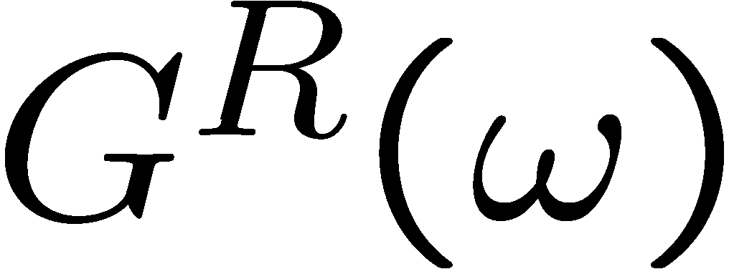
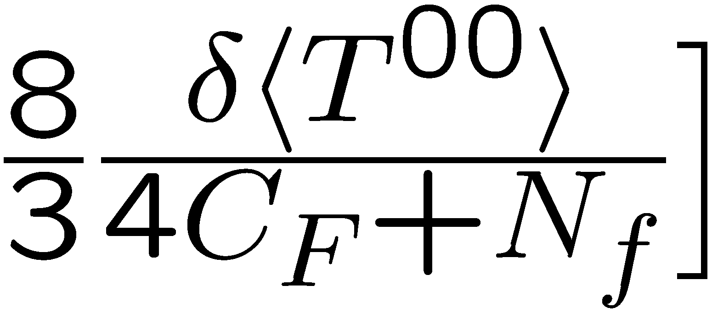
Sum rule 2
Replace
by
UV term
IR term

Slide 15
Summary
Sum rule 1
Sum rule 2
Sum rule 3

Slide 16
Lesson to be learned from sum rules
Ansatz used for fit to lattice QCD data:
H.T. Ding et al., Phys. Rev. D 83, 034504 (2011).
causes divergence in sum rule 2
causes divergence in sum rule 3
needs improvement if sum rules are taken seriously
for instance with

Slide 17
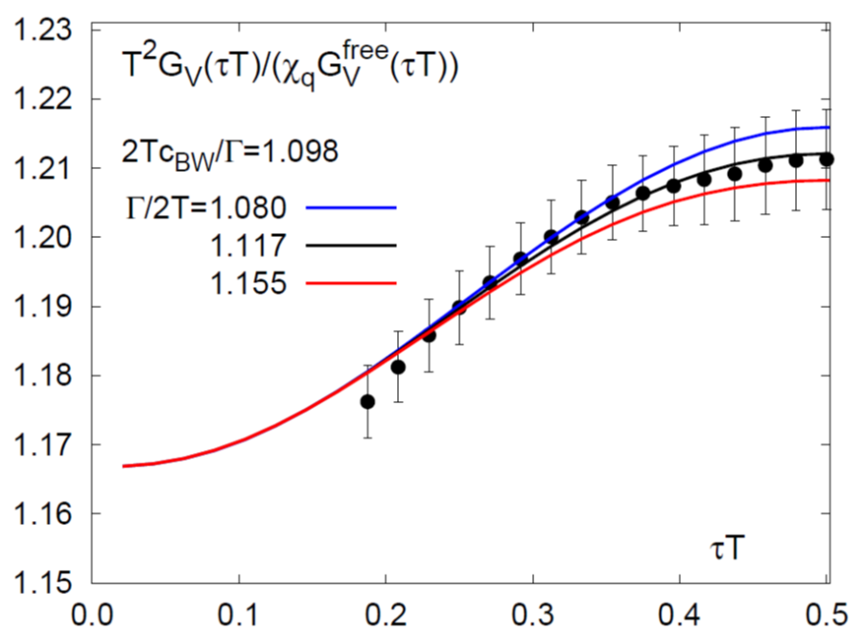
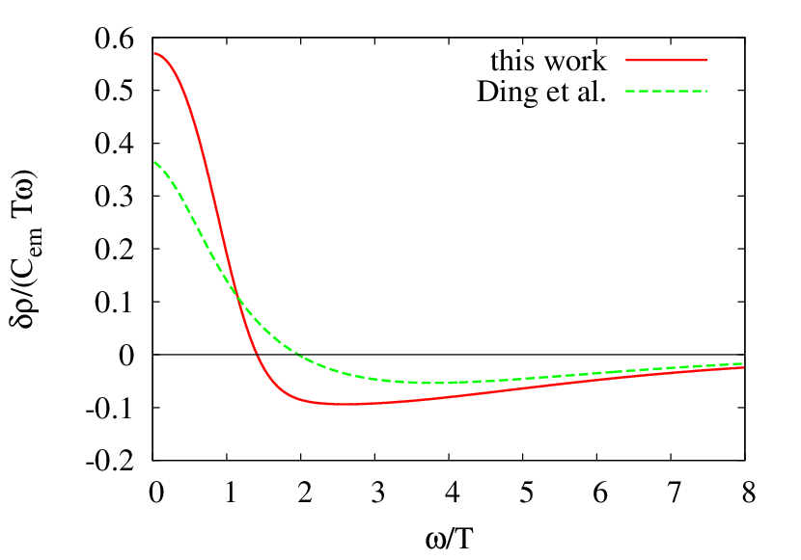
Trial fit analysis of lattice QCD data
fitted with above ansatz
H.T. Ding et al., Phys. Rev. D 83, 034504 (2011).
use sum rule 3 to obtain τ_{J}:

Slide 18
Summary
We have derived three sum rules for the temperature dependent part of the vector channel spectral function at finite temperature.
Constraints for spectral fits to lattice QCD data
We have checked that the sum rules are satisfied at weak coupling and in the chiral limit.
See our papers
We have proposed an ansatz that is consistent with all three sum rules.

Slide 19
Backup slides

Slide 20
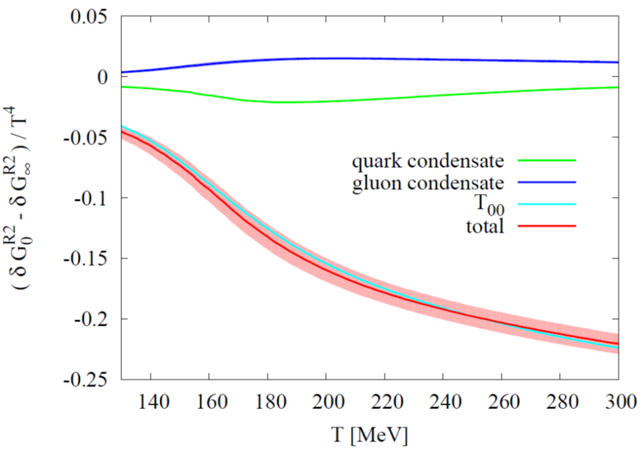
Sum rule 2
Input: T dependence of quark and gluon condensates
Computable with help of trace anomaly and lattice QCD
Lattice data taken from:
A. Bazavov et al. (HotQCD Collaboration), Phys. Rev. D 90, 094503 (2014).

Slide 21
Sum rule 3
Start from
Subtract “sum rule 1” and –σω’, take the ω’ → 0 limit:
Subtraction of σω prevents divergence of integral at ω=0

Slide 22
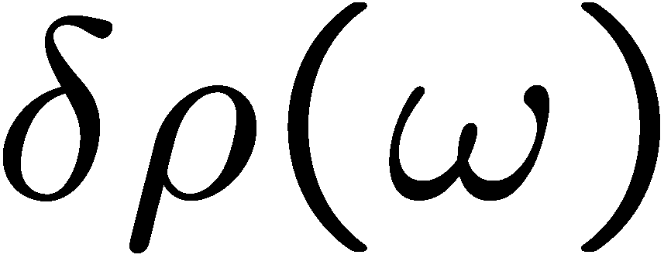
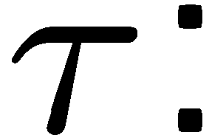
Checks at weak coupling and chiral limit
transport peak
From Boltzmann equation within relaxation time approximation
relaxation time
continuum
Sum rule 1:
transport peak
continuum
OK!

Slide 23
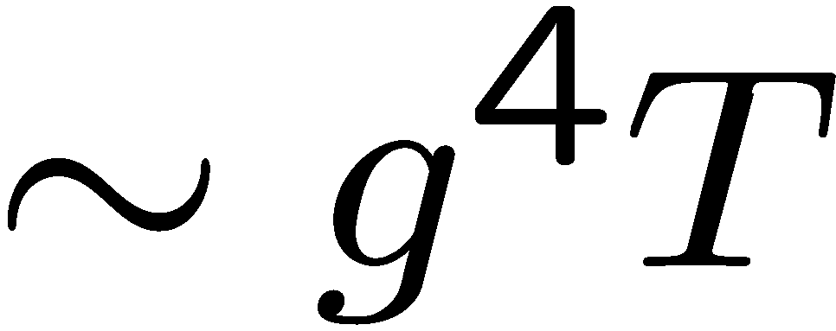
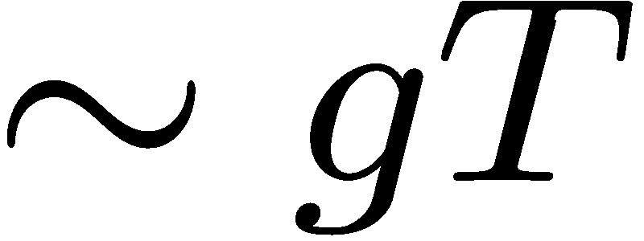
Sum rule 2:
chiral limit
weak coupling
transport peak
continuum
OK!
Sum rule 3:
transport peak
continuum
OK!

