Slide 1
ILCにおける中性子発生
Neutron production with ILC
Kenji MISHIMA
KEK, J-PARC
kenji.mishima@kek.jp
ＩＬＣの多角的活用を考える会II
2018/Jul/6th, 京都大学宇治キャンパス

Slide 2
Contents
Neutron production reactions
Neutron production at ILC
Applications

Slide 3
Neutron production reactions

Slide 4
Neutron production reactions
Nuclear reaction
  ⁹Be + 𝛼 → n + ¹²C
  ⁷Li + p → n + ⁷Be
  ⁹Be + 𝛾→ n + ⁸Be
Fission
  ²³⁵U + n → Fission Products + 2.4 n
Fusion
  D + T → n + ⁴He E_{n} = 14.1 MeV
  D + D → n + ³He E_{n} = 2.5 MeV
Spallation
  Hg + p(~GeV) → Fission Products + ~20 n

Slide 5
Photo Nuclear Reactions
Two candidates for photo nuclear reactions:
  Light and Heavy nuclei
⁹Be + 𝛾→ n + ⁸Be (S_{n} = 1.665 MeV)
D + 𝛾→ n + p (S_{n} = 2.225 MeV)
  Pros: Low S_{n} , No structure(monochromatic neutron), small photo attenuation
  Cons: Small cross section
Heavy Nuclei (²⁰⁸Pb S_{n}= 7.368 MeV etc.)
  Pros: Large Cross section
  Cons: Nuclear structure makes broader neutrons, Large photo attenuation (large energy deposit)

Slide 6

Photo Nuclear Reactions
⁹Be(γ,nα)⁴He
Threshold = 1665.3 keV
σ(γ,n) is 1.2 mbarn at 1690 keV (E_{n}=25 keV)
Due to detailed balance,
the cross section near the
threshold is expected to be
⁹Be(γ,nα)⁴He cross section
$$σ_{(γ,n)}∝1/E_{n}$$
C.W.Arnold et al., PhysRevC.85.044605

Slide 7
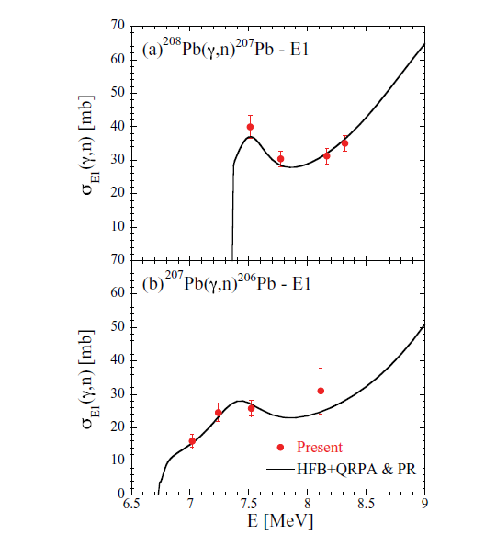
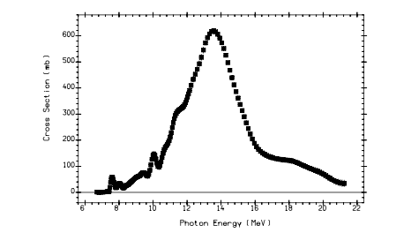
Photo Nuclear Reactions
²⁰⁸Pb (γ,n)²⁰⁷Pb
Threshold (²⁰⁸Pb) = 7368 keV
σ(γ,n) is
  600 mbarn at 13 MeV
  (E_{n}=5.6 MeV)
  at giant dipole resonance (GPR)
  40 mbarn at 7.500 MeV
  (E_{n}=130 keV)
  at pigmy dipole resonance (PDR)
²⁰⁸Pb(γ,n) ²⁰⁷Pb
PDR resonance
GDR peak
n
p
“Atlas of Giant Dipole Resonances”
(1999) INDC(NDS)-394 Distr. GN+NM
T. Kondo et al., PHYSICAL REVIEW C 86, 014316 (2012)

Slide 8
Estimation of neutron production
⁹Be with 1.690 MeV gamma
Parameter | Value
Target | ⁹Be
Threshold | 1.66531 MeV
Gamma energy | 1.690 MeV
Neutron energy | 25 keV
Number density | 0.124 atoms/barn/cm
⁹Be(γ,n)⁸Be cross section | 1.2 mbarn
Photo attenuation length | 33 cm
Gamma to neutron conversion rate | 0.61%
Energy input per neutron | 280 MeV
Cf. 50 MeV / neutron for spallation reaction

Slide 9
Estimation of neutron production
²⁰⁸Pb with 13 MeV gamma
Parameter | Value
Target | ²⁰⁸Pb
Threshold | 7.368 MeV
Gamma energy | 13 MeV
Neutron energy | 5.6 MeV
Number density | 0.033 atoms/barn/cm
²⁰⁸Pb(γ,n)²⁰⁷Pb cross section | 600 mbarn
Photo attenuation length | 1.6 cm
Gamma to neutron conversion rate | 3.2%
Energy input per neutron | 410 MeV
Cf. 50 MeV/neutron for spallation reaction.

Slide 10
Estimation of neutron production
²⁰⁸Pb with 7.5 MeV gamma
Parameter | Value
Target | ²⁰⁸Pb
Threshold | 7.368 MeV
Gamma energy | 7.5 MeV
Neutron energy | 132 keV
Number density | 0.033 atoms/barn/cm
²⁰⁸Pb(γ,n)²⁰⁷Pb cross section | 40 mbarn
Photo attenuation length | 1.9 cm
Gamma to neutron conversion rate | 0.25%
Energy input per neutron | 3000 MeV
Cf. 50 MeV/neutron for spallation reaction.

Slide 11
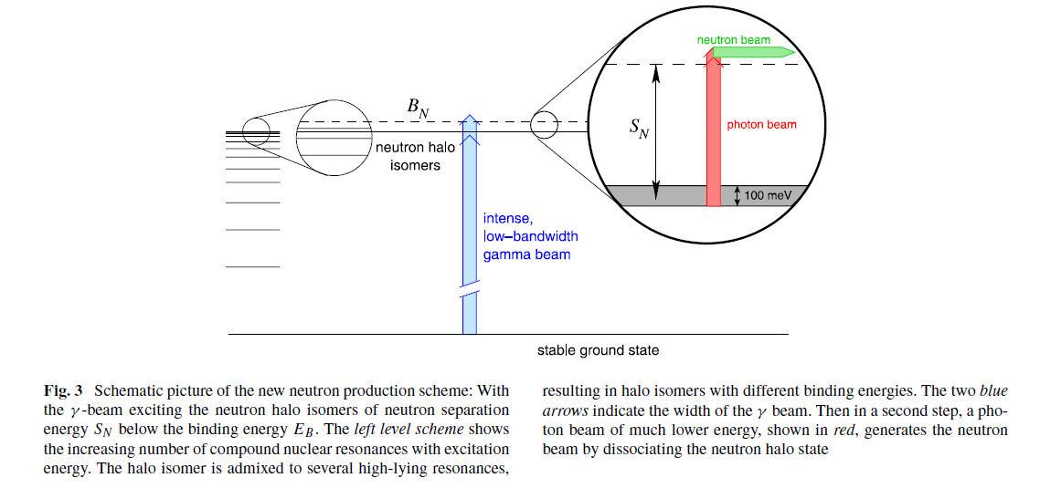
Neutrons source using
Neutron halo isomers in stable nuclei
Neutron production by laser/X-ray by neutron halo isomer exited by ICS gamma was proposed by Habs et al. If we can find such a good nuclei, very intense eV-neutrons can be obtained.
Habs, D., et al. "Neutron halo isomers in stable nuclei and their possible application for the production of low energy, pulsed, polarized neutron beams of high intensity and high brilliance." Applied Physics B 103.2 (2011): 485-499.

Slide 12
Summary of photo neutron reactions
Photo neutron reactions
  Cross sections are 1 to 600 mbarn.
  Production rate is order of 1%.
  Energy per neutron production is ~300 MeV, which is 6 times larger than spallation reaction (50 MeV).
From the point of view of engineering, the heat removal of the target is very important.
  Ex. J-PARC spallation neutron source
    3GeVx333uA=1MW
    Total neutron production is ~10¹⁷/s

Slide 13
Neutron production at ILC

Slide 14
Distribution of the Beam Dumps
This slide is from K. Yokoya.
Most practical use of extracted beam is the ones at the location of the beam dumps (Otherwise, extraction system must be added, which occupies a longitudinal length. Must be planned early.
Distribution of the Beam Dumps is shown below
blue: electron, red: positron
The numbers shown are the upper limit of the beam power to be dumped (20% margin included)
  Mostly for commissioning or emergency except E-5, E+5, E+7, E-8
  Hence the power of the full beam power at the beam line nearby is more than the number here
  The full beam can be dumped only at E-5, E+5, E+7 (The upper limit of the dumps exceeds the full power because future upgrades are taken into account)
E-8 will not be built in ILC250GeV
Yellow arrows indicate the bunch compressors. The rms bunch length is 6mm in the upstream (from DR) and 0.3mm in the downstream.
Bunch Compression
Bunch Compression
E+7
E-4

Slide 15
Beam Dump Specification
This slide is from K. Yokoya.
PB max = The maximum beam power at the nearby beamline for ILC250GeV
W = Upper limit of beam dump power (20% margin included)

Slide 16
[E+7]
Photons from the undulators to produce positron
  This is absent if the e-driven scheme is chosen for positron production
No variety in the operation mode in case of ILC250GeV
  Electron energy 125GeV
  (more precisely, 128GeV at undulater section entrance and 125GeV at exit)
  Average energy of all photons 6.3 MeV
  Number of photons generated (about 400 photons from each electron)
  per bunch 8 x 10¹²
  per second 5.2 x 10¹⁶
  Average energy of photons reaching the target 9.7 MeV
  (Low energy part is eliminated at the masks/collimators)
  Photon power at the target ~ 50 kW
The target is thin (0.2X₀). Most photons go through the target and reach the photon dump

Slide 17
Photon Energy Distribution on Target
This slide is from K. Yokoya.
⁹Be/D
²⁰⁸Pb
x
black: no mask
red: with masks
blue: with masks & collimator (r=2.2mm)

Slide 18
Neutron production at E+7 undulator
Parameter | Value
Photon luminosity
Photon flux
Photon intensity | 5.2 x 10¹⁶ photon/s
Total Energy of photon | 50 kW
Target | ²⁰⁸Pb
Gamma energy | 7.5 MeV
Neutron energy | 130 keV
Gamma to neutron conversion rate | 0.25%
Total neutron production | 1 x 10¹⁴ neutron/sec
1/1000 of J-PARC

Slide 19
Neutron production at E+7 undulator
Parameter | Value
Photon luminosity
Photon flux
Photon intensity | 5.2 x 10¹⁶ photon/s
Total Energy of photon | 50 kW
Target | ⁹Be
Gamma energy | 1.670-1.690 MeV
Neutron energy | 5-25 keV
Gamma to neutron conversion rate | 0.6%
Total neutron production | 3 x 10¹⁴ neutron/sec
1/300 of J-PARC

Slide 20
[E-4, E+4]
This slide is from K. Yokoya.
Right after ML (main linacs)
Energy 125 GeV
emittance 5μm.rad x 35 nm.rad
Energy spread 0.19% (e-), 0.15% (e+)
  Energy spread of e- is larger because of the radiation in undulator
Bunch length 0.3mm
  As at E+-6, Must be fixed to 0.3mm during collision experiments, but the the bunch compressor itself is capable of compressing the bunch down to at least 0.15mm. (But the energy spread would be doubled.)
  Therefore, if 0.15mm is absolutely needed, it might be possible to borrow a machine time hours/days
Full beam power 2.5MW, beam dump < 400kW
In case of `stealing’ ~10% the reinforcement of beam dump is not needed
Note: The beam parameters at [E-7] are similar to above but the maximum power for this dump is limited to 60kW (because [E-7] is an emergency dump to protect the undulators) . Therefore, the use of [E-7] is presumably less useful than at [E-4, E+4]

Slide 21
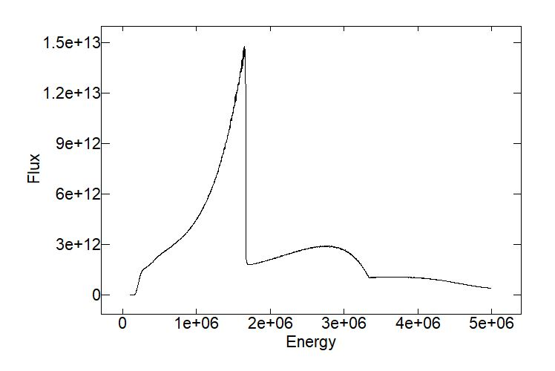
This slide is from S.Sasaki.
Possibility of neutron source using photon beam from ILC
ILC main linac parameters @ E-4
Normalized emittance γε : 5.0 x 10⁻⁶ m·rad
Total emittance at 125 GeV: 2.0 x 10⁻¹¹ m·rad
Beam current: 0.58 mA (10% of main current)
Undulator parameters
Undulator period l : 6.5 cm
Undulator strength K : 0.61
Undulator type: helical
Active undulator length: 20 m
Field on-axis: 0.1 T
Partial Flux thr 25 urad aperture
Peak Photon Energy = 1.66 MeV

Slide 22
Neutron production at E-4 undulator
Parameter | Value
Photon luminosity | 1.5 x 10¹³ photon/25urad/0.1%B.W/s
Photon flux
Photon intensity | 1.5 x 10¹⁴ photon/s (5-25 keV)
Total Energy of photon | 40 W
Target | ⁹Be
Gamma energy | 1.670-1.690 MeV
Neutron energy | 5-25 keV
Gamma to neutron conversion rate | 0.6%
Total neutron production | 1x10¹² neutron/sec
10⁻⁶ of J-PARC

Slide 23
Summary of neutron production at ILC
E+7 and E-4 is candidates.
  5x10¹⁶ photon/s (50 kW) at E+7 undulator in 100% B.W.
  10¹⁴ photon/s at (40 W) at E-4 undulator in 1%B.W.-25 urad
Because the neutron production rate is ~0.3-0.6%, neutron production rate is 10¹²-10¹⁴ neutron/s.
Velocity of 30 keV neutron is 2.4x10⁶ m/s.
If we use bunch structure of 552 ns, TOF length should be less than 1.2 m.

Slide 24
Applications

Slide 25
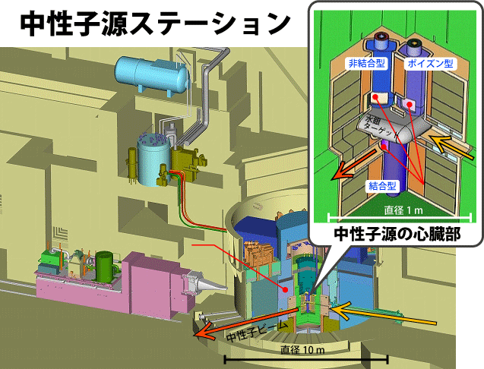
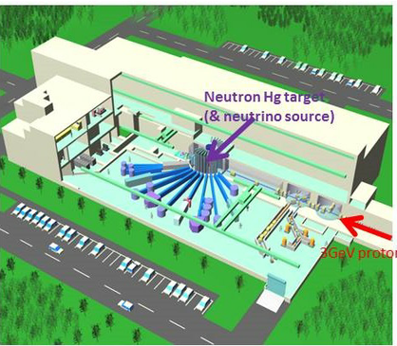
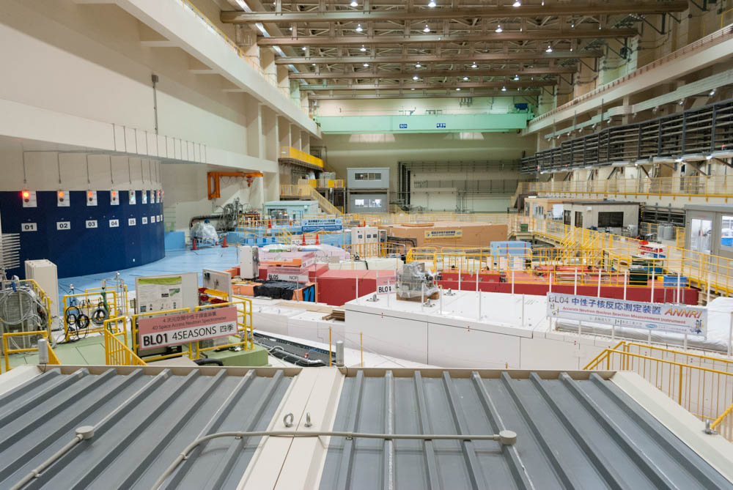
J-PARC Neutron/Muon Lab. (MLF)
Neutron target station
1-MW Hg spallation target for neutron source.
Because of pulse structure, ILC neutron facility will be MUCH smaller.
60 m
150 m

Slide 26
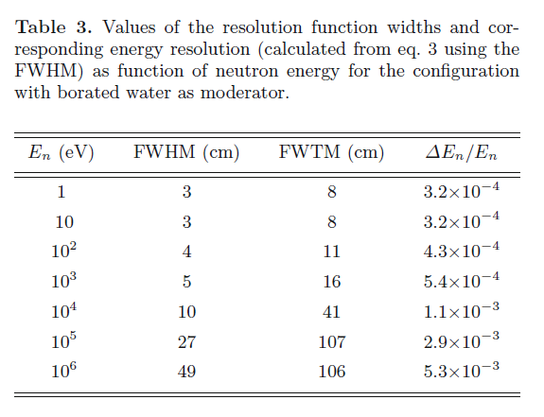
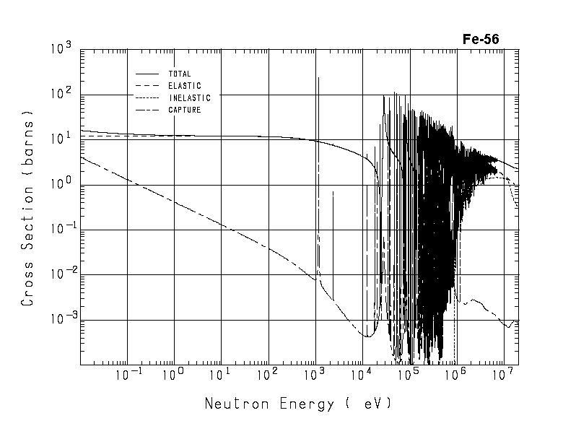
Application of keV/MeV neutrons
Neutron cross section measurement with high energy resolution by transmission.
  n_TOF@CERN, ANNRI@JPARC, Los Alamos.
keV neutron detector
Resolution of n_TOF@cern
C. Guerrero et al., Eur. Phys. J. A (2013) 49: 27
Neutron source
~φ100 μm
1m
sample
1 m
φ100 μm keV neutron source is possible to measure total cross section with resolution of 10⁻⁴, which is better than n_TOF@CERN.

Slide 27
Application of keV/MeV neutrons
Neutron microscopic imaging
Neutron imaging with keV/MeV neutrons.
  1000 times larger image can be obtained at sample potions at 1 mm.
keV/MeV neutron detector
Sample
Neutron source
~φ100 μm
1m
1 mm
1 mm
1 m

Slide 28
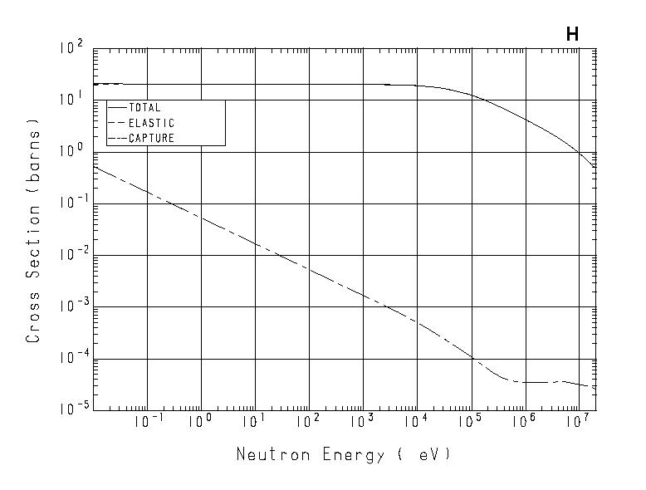
Neutron moderation
とある小型中性子源モデレーターの計算
2 barn@2MeV
20 barn@20 keV
低エネルギーのほうが有利だが2~3倍程度
最適化すればもっと効率は上がるか？

Slide 29
Summary
Photo-neutron reaction rate was calculated.
  For ⁹Be(g,n) at 1.690 MeV
  Gamma to neutron conversion rate ~ 0.6%
  Energy input per neutron ~ 280 MeV/n
  Cf. ~ 50 MeV/n for spallation neutron (J-PARC)
5x10¹⁶ 𝛾/sec produces 10¹⁴ n/sec of keV neutrons.
  1,000 times less production than J-PARC
  Heat on the target (50 kW) is the problem.
Application
  keV neutron with TOF
  Thermal neutron with compact moderation
  Direct eV neutron production

