Slide 1
Non-invasive Beam Position Monitor Research in HUST-PTF
Li jiqing
Institute of Applied Electromagnetic Engineering
School of Electrical and Electronic Engineering
Huazhong University of Science and Technology
应用电磁工程研究所
2018.09.18
1
Notes:
Hello everyone, my topic today is “Non-invasive Beam position monitor Research in HUST-PTF.

Slide 2
Background
Beam diagnostic devices in HUST-PTF
Non-invasive BPM research
Summary
Notes:
My topic consists of 4 parts. Firstly, I will introduce the HUST-Proton therapy facility. Then I will introduce the beam diagnostic devices in HUST-PTF. After that , Non-invasive BPM research in HUST-PTF beamline will be introduced. Now we have bought some beam diagnostic devices, such as faraday cup , scintillating screen detector.
As for beam position monitor, we bought some ionization chambers from NTG. Now we plan to develop a Non-invasive BPM to replace it. Lastly, it’s a summary

Slide 3
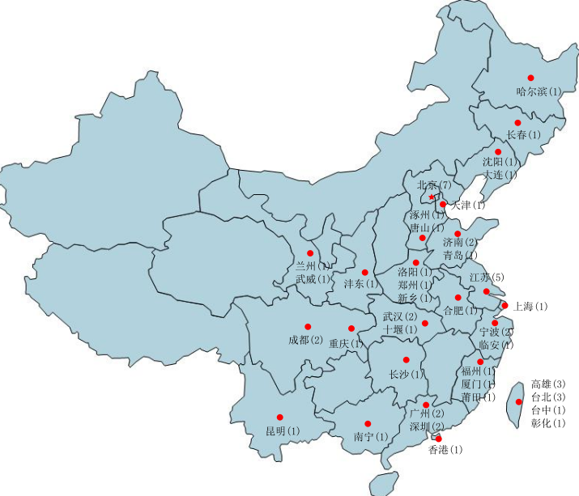
Background
More and more proton therapy facilities in China
There are more than 60 proton therapy facilities planned to build
Most equipment relies on imports
shanghai PTF project
Wuhan -PTF project
Government plan：
Developing domestic PTF
Industrialization
2 projects supported by Chinese government
Shanghai-PTF,(synchrotron)
Wuhan-PTF, (cyclotron)

Slide 4
Background
HUST-PTF
A superconducting cyclotron，A beamline with energy selection system, two rotating gantries, a fixed treatment room.
250 MeV/500nA
superconducting cyclotron
Two 360°rotating gantries
The fixed treatment room
The degrader and energy selection system:
70 -250 MeV
The beamline
Notes:
HUST-PTF is a dedicated proton therapy facility. A superconducting cyclotron generates 250MeV/500nA proton beam, and beam frequency is 73MHz. the degrader and energy selection system can adjust the beam energy from 70-250MeV. A fixed treatment room and two rotating gantries are used to treat patients.

Slide 5
Beam Diagnostic Devices in HUST-PTF
Notes:
There is HUST-PTF beam diagnostic devices layout. There are 3 kind of devices: faraday cup to measure beam current 、scintillating screen to detect the beam profile and ion chamber to detect the beam position. The ion chamber won’t stop the beam but It will have a little effect on the beam.Now most of these beam diagnostic devices are bought from some companies. Now we want to develop a kind of non-invasive beam diagnostic device to replace the ion-champer

Slide 6
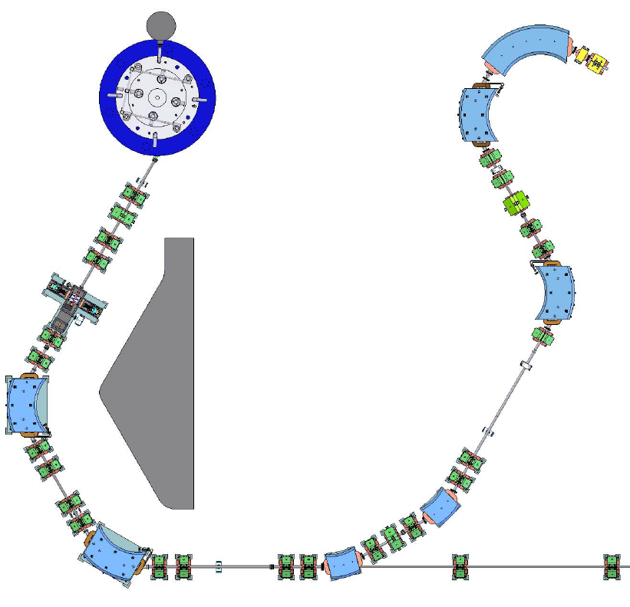
Beam diagnostic devices in HUST-PTF
Mode | CW
Bunch length | ~200mm
Bunch frequency | 73MHz
Bunch charge | See Table below
Beam energy | See Table below
Beam radius(RMS) | 2~10 mm
P6: End
P1: Exit of Cyclotron
P2: Degrader
P5: Connection Point
Position | Energy（MeV） | Average Current（nA）
[P1，P2] | 250 | 500
[P2，P3] | 70~230 | 2.65~105
[P3，P4] | 70~230 | 0.4~89
[P4，P6] | 70~230 | 0.4~4
P3：Slit
P4：Collimator
Notes:
There is a introduction to the beam parameters. The mode is CW, the bunch length is about 200mm, bunch length is 73MHz. At the exit of cyclotron, particle energy is 250 MeV, average current is 500nA. Degrader can adjust the beam energy from 70-230MeV and the average current from 2.65 to 105nA. Slit and collimator will further reduce the beam current. After the collimator, the beam current is reduced below the 4nA. Now we want to develop a non-destructive BPM after the collimator to replace the ion chamber. And the greatest challenge is that the beam current is very low. It is different to get large enough signal with satisfactory Signal-to-noise ratio

Slide 7
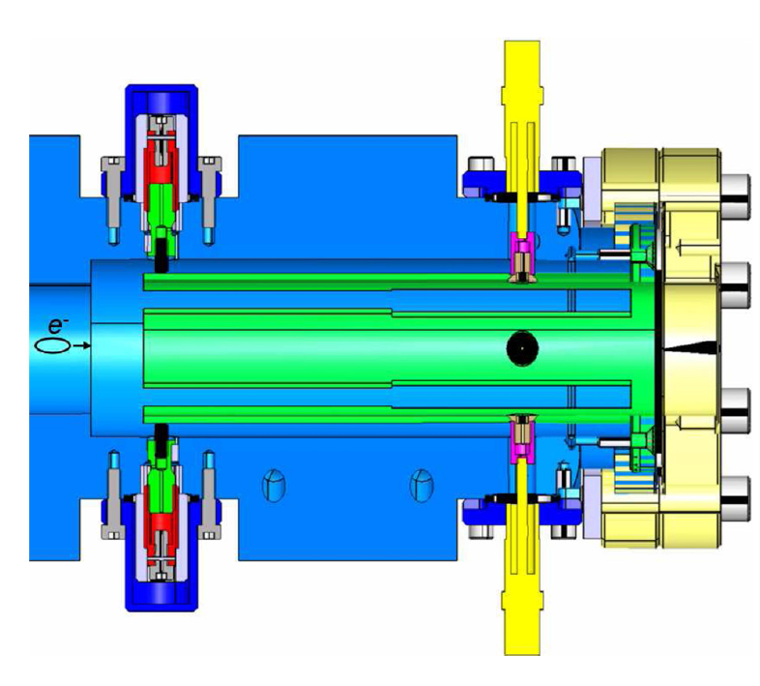
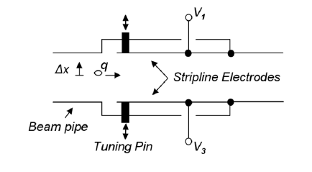
Non-invasive BPM research
The resonant stripline BPM
Figure 1: Resonant stripline pickup, one plane only.
Figure 2. Construction drawing in the SwissFEL test injector.
Notes:
According to our survey, the resonant strip line BPM may be an choice for us. The left figure is a resonant stripline pick up. It is a new strip line BPM design. the coupling of the signal outputs to the electrode was deliberately mismatched to create a resonance at the harmonic of the RF frequency 。Refer to the experience of PSI, an overall shunt impedance of 2.9 kOhms and power output levels of an order of -120 dBm at the design current of 1 nA. Adding a low noise RF front end and a sophisticated digital receiver should allow a performance suitable. The resonators are excited at the gap at the open-circuit end, and the signal is extracted by direct tapping near the short-circuit end. The fundamental resonance that we use has four associated modes: A monopole mode (all voltages in-phase) with magnitude proportional to the bunch charge, two dipole modes (one mode per plane with voltages from opposite electrodes 180° out-of-phase) proportional to the horizontal (X) and vertical (Y) beam positions times the bunch charge, Furthermore, a ceramic tuning screw for each strip allows adjusting the radial positions of the open strip ends and thus the resonance frequency of each strip very precisely and efficiently. The feedthroughs (50Ω line impedance) are put in the region where the magnetic field of the modes is mostly concentrated. (
coaxial cavity

Slide 8
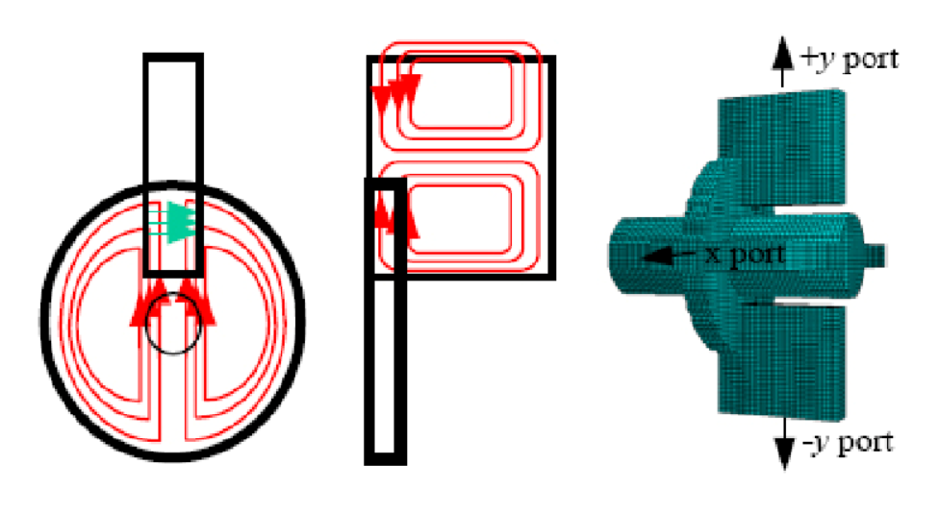
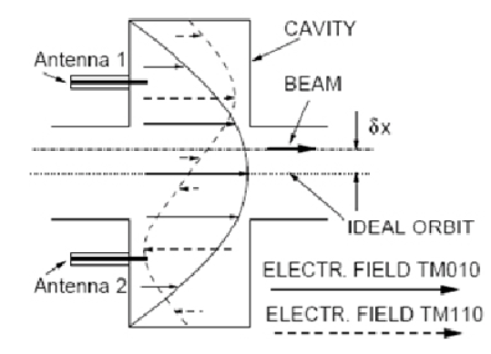
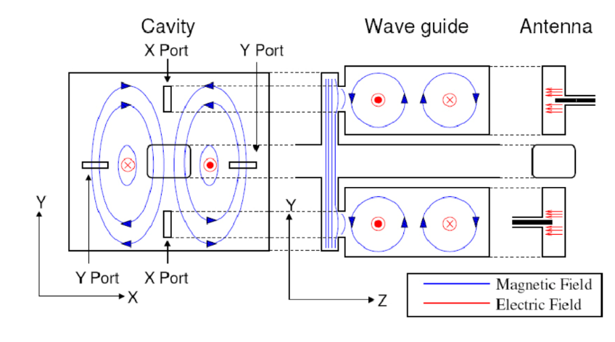
Non-invasive BPM Research
Figure 2: Cylindrical cavity BPM
Figure 1: Monopole and dipole modes in cavity BPM
Figure 3: Rectangular cavity BPM
Notes:
In resonant cavities the beam excites special field resonating at a certain frequency. The amplitude of these modes depends on the cavity orientation, the bunch charge, the beam position, and its spectrum. Dipole modes are used for position detection, since their amplitude depends linearly on the beam position and is zero for a centered beam. The signals excited in the cavity are extracted by wave guides or probes. the information about the position is given directly. Because of the large signal per micron displacement, these resonant monitors find application in situations where the beam signals are weak. Usually, cylindrical cavity BPM and rectangular cavity BPM are used. But the frequency of proton beam in HUST is 73 MHz, the frequency is low. Because dipole modes are used for position detection and dipole modes frequency is multiple of beam frequency, the cavity BPM size is too big.

Slide 9
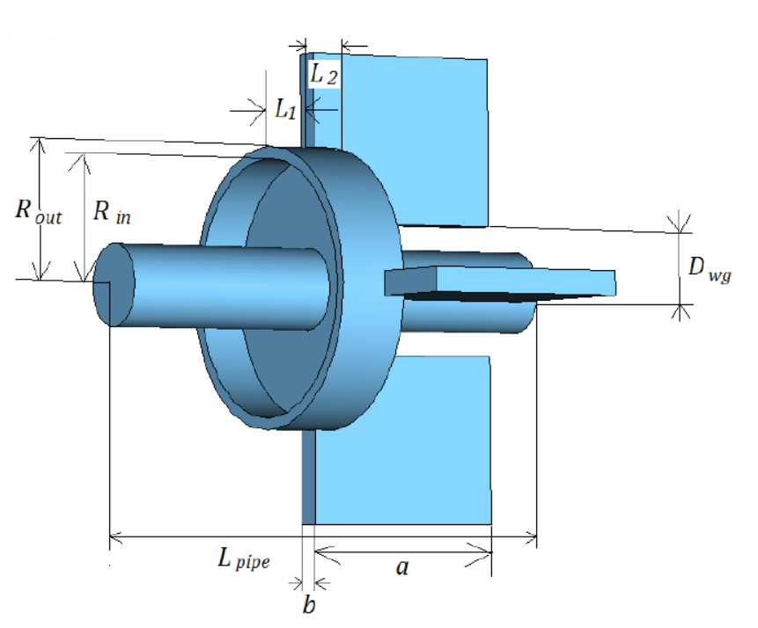
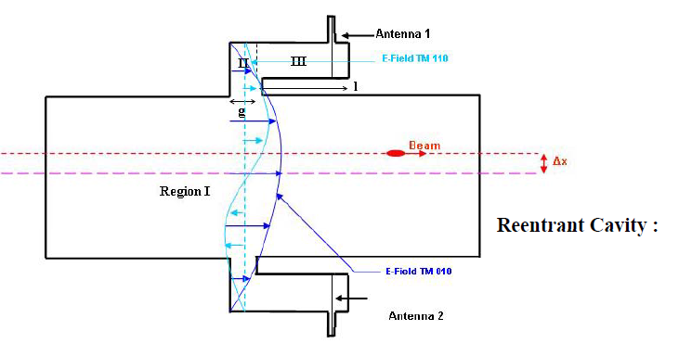
Non-invasive BPM Research
Reentrant Cavity BPM
Figure 1: a reentrant cavity BPM model in CST
Figure 2: a reentrant cavity BPM （one plane only）
Notes:
So maybe Reentrant Cavity BPM is a choice for HUST-PTF. Figure 1 is a reentrant cavity BPM model in CST . And figure 2 is a reentrant cavity BPM , one plane only. The principle is similar to the common cylindrical cavity and rectangular cavity. The Monopole mode is used to detect beam intensity and dipole mode is used to detect beam position .But because of the reentrant structure, compared with cylindrical and rectangular cavity, the reentrant cavity BPM is more compact in radial and the Q is smaller. If we set the triple frequency as working frequency, the reentrant cavity radius is about 15cm, which maybe is acceptable .

Slide 10
Summary
A proton therapy facility in Wuhan is planned to build. Now we have bought some destructive beam diagnostic devices to measure the beam profile and position.
We want to develop a non-invasive beam position monitor in the beamline. Further research will be done about resonant stripline BPM and reentrant cavity BPM.
If you have any suggestion, welcome to discuss with us. The beam diagnostic group in HUST-PTF has just been established and most of us are young, we need your suggestions.

Slide 11
Thank you!

