Slide 1
Neutron resonance imaging with ILC photo-neutrons
Kenji MISHIMA
KEK, J-PARC
kenji.mishima@kek.jp
ＩＬＣの多角的活用を考える会 III
2018/Nov/13th, KEKつくばキャンパス

Slide 2
Neutron production reactions

Slide 3
Photon Energy Distribution on Target
This slide is from K. Yokoya.
⁹Be/D
²⁰⁸Pb
x
black: no mask
red: with masks
blue: with masks & collimator (r=2.2mm)

Slide 4

Photo Nuclear Reactions
⁹Be(γ,nα)⁴He
Threshold = 1665.3 keV
σ(γ,n) is 1.2 mbarn at 1690 keV (E_{n}=25 keV)
Due to detailed balance,
the cross section near the
threshold is expected to be
⁹Be(γ,nα)⁴He cross section
$$σ_{(γ,n)}∝1/E_{n}$$
C.W.Arnold et al., PhysRevC.85.044605

Slide 5
Estimation of neutron production
⁹Be with 1.690 MeV gamma
Parameter | Value
Target | ⁹Be
Threshold | 1.665 MeV
Gamma energy | 1.690 MeV
Neutron energy | 25 keV
Number density | 0.124 atoms/barn/cm
⁹Be(γ,n)⁸Be cross section | 1.2 mbarn
Photo attenuation length | 12 cm
Gamma to neutron conversion rate | 0.18%
Energy input per neutron | 950 MeV
Cf. 50 MeV / neutron for spallation reaction

Slide 6
Estimation of neutron production
⁹Be with 1.690 MeV gamma
Parameter | Value
Repetition | 5 Hz
Stored bunches | 1312
Photons/bunch at 1.7 MeV | 8×10⁸/keV
Bunch interval | 552 ns
⁹Be(γ,n)⁸Be cross section at 1.7 MeV | 1.5 mb
Photo attenuation length | 12 cm
γ to n conversion rate | 0.22%
Neutron production/bunch | 1.4×10⁶/keV/bunch
Total neutron production rate | 2×10¹²/s

Slide 7
Photon (x-y) Distribution on Target
⁹Beターゲット位置での幅はわからなかったのでざっと2x2mmとした。
With masks
See slightly larger horizontal size due to horizontal emittance (horizontal betatron oscillation in the undulator section)
Only randomly selected particles are plotted here
Total number of macro particles is ~400k

Slide 8
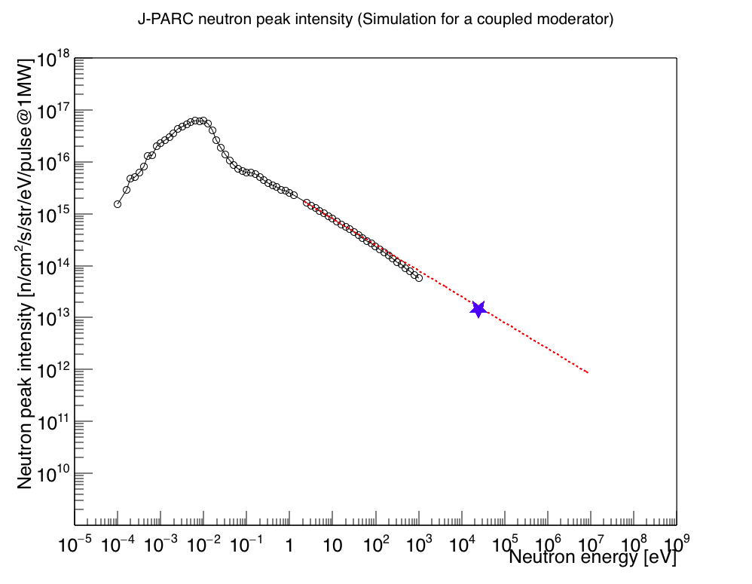
Peak intensity
ILC phot-neutron vs. J-PARC
Peak intensities (Phase space density) of ILC phot-neutron and J-PARC were plotted on the same graph.
Y_{n} = 1.4x10¹³ n /eV/ cm²/str/s
ILC photo-neutron by ⁹Be is Comparable to J-PARC(1MW).
ILC E+7
⁹Be target
Total number of neutron production
J-PARC: 1MW x 50 MeV/neutron = 1.5x10¹⁷ n/s
ILC gamma(⁹Be): 2x10¹² n/s

Slide 9
Application of ps pulsed neutron

Slide 10
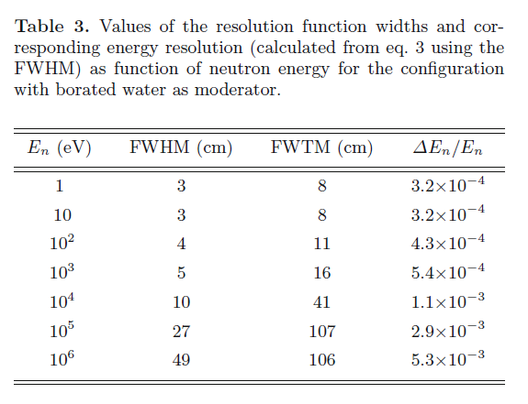
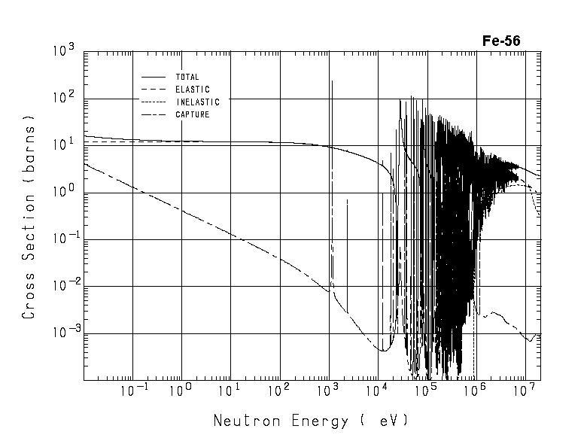
Application of keV/MeV neutrons
Neutron cross section measurement with high energy resolution by transmission.
  n_TOF@CERN, ANNRI@JPARC, Los Alamos.
keV neutron detector
Resolution of n_TOF@cern
C. Guerrero et al., Eur. Phys. J. A (2013) 49: 27
Neutron source
~φ100 μm
1m
sample
1 m
φ100 μm keV neutron source is possible to measure total cross section with resolution of 10⁻⁴, which is better than n_TOF@CERN.

Slide 11
Application of keV/MeV neutrons
Neutron microscopic imaging
Neutron resonance imaging with keV neutrons.
  100 times larger image can be obtained at sample potions at 1 mm.
  High resolution TOF imaging can distinguish nuclei by keV resonances.
keV/MeV neutron detector
Cross section
Sample
Neutron source
~φ1mm ³
1m
10 mm
10 mm
1 m

Slide 12
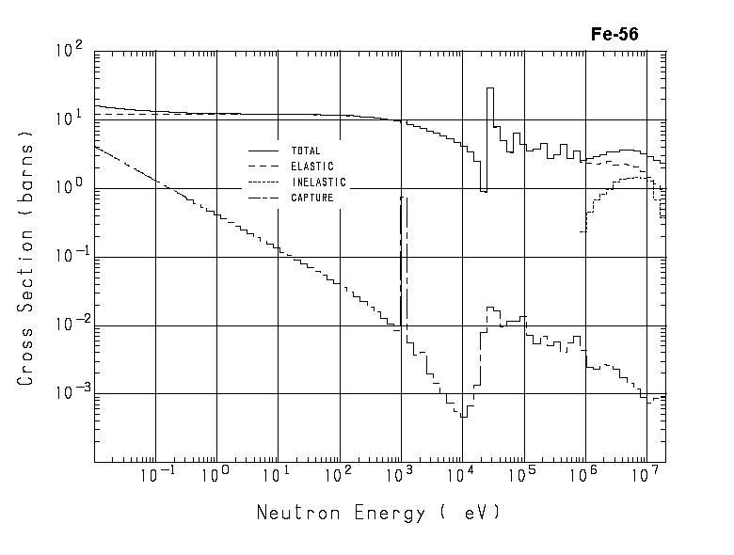
Neutron resonances (⁵⁶Fe)

Slide 13
Neutron resonances (⁵⁶Fe)

Slide 14
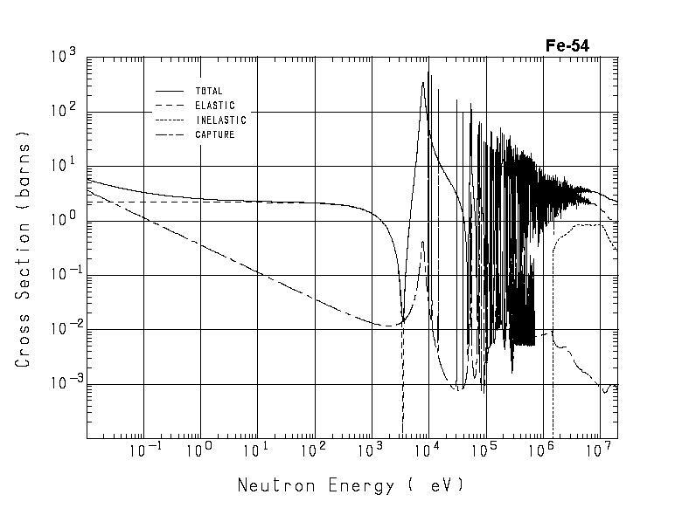
Neutron resonances ⁵⁴Fe

Slide 15
性能
発生幅は0.3 mm(1ps)なので、この領域での発生数に焼き直すと1 mm 角だと
  Y_{n} = 2.9 n /eV/mm³ (3ps) /bunch
長さdとして検出器、ターゲットの厚さΔdで決まる。
  d = 1 m, Δd = 1 mmとした場合、Δd/d = 1x10⁻³
  エネルギーの決定精度ΔE/Eは2x10⁻³
繰り返し周期は552 nsであるので、TOF距離を1 mとするとエネルギー下限は17 keVになる。

Slide 16
透過率計算
1 mmのサンプル(鉄)を測定すると仮定。
  透過率 T = 1 - exp(-ρLσ) = 1- 0.0084σ [barn]
  1 barnで1%くらい
  ⁵⁶Feの26 keVのピークは50 barn 幅5%くらいなので十分観測にかかるはず。

Slide 17
まとめ
ILC E+7からの中性子量を計算した。
  Y_{n} = 2.9 n /eV/mm³ (3ps) /bunch
  25 keVではJ-PARC 1MWとconsistent
  psパルスの応用を考えたい。
中性子透過測定(イメージング)を検証。
  (がんばれば) CERN n_tofを超える分解能。
  同位体分析ができるが何か良い応用はあるか？
    ターゲットを小さくして1mmくらいの微小サンプル測定？
  同位体をイメージングしていいことあるか？

Slide 18
⁵⁴Fe

Slide 19
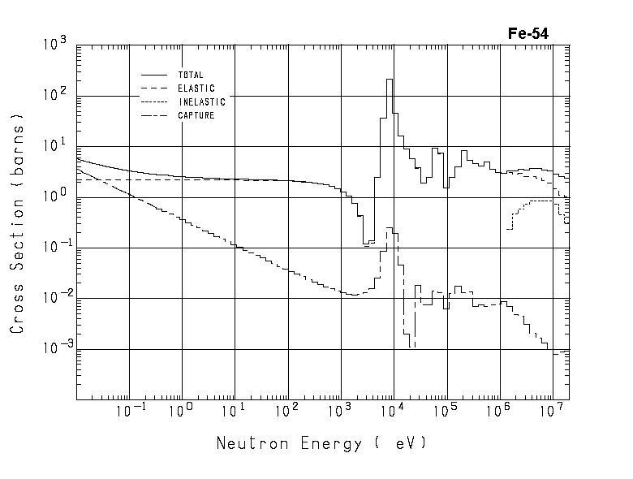
⁵⁴Fe

