Slide 1
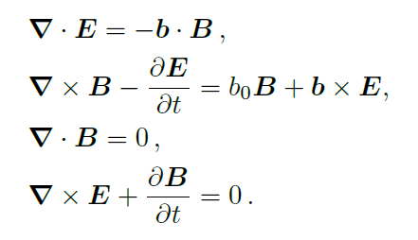
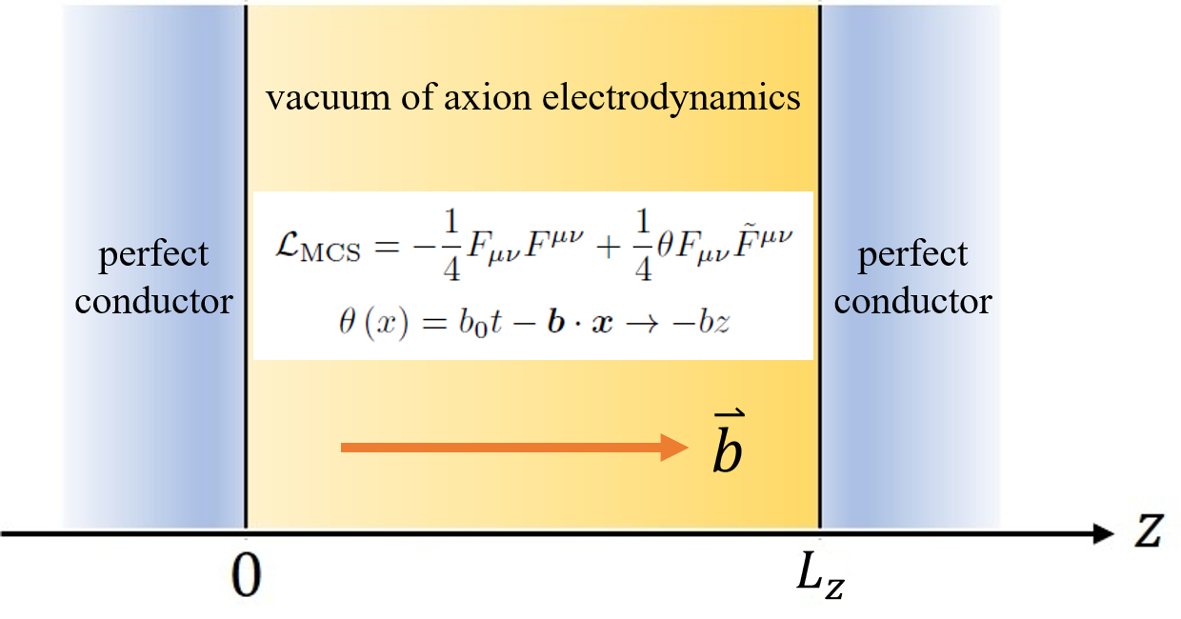
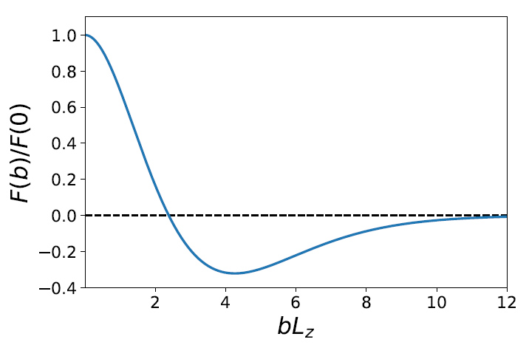


Anomalous Casimir Effect in Axion Electrodynamics
Axion Electrodynamics
Witten Effect
Our theoretical framework is the axion electrodynamics described by the Maxwell-Chern-Simons (MCS) equation. It contains a Chern-Simons-like term $\frac{1}{4}θ\left(x\right)F_{μυ}{\tilde{F}}^{μυ}$ in the Lagrangian, with the background axion field $θ\left(x\right)=b_{μ}x^{μ}$.
This model successfully accounts for several novel effects induced by quantum anomaly, attracting great attention in high energy nuclear experiments. This theory also plays a significant role in the study of Lorentz-violating extension of the Standard Model.
Recent development of condensed matter physics materials like topological insulator and Weyl semimetal provides the experimental realization of anomalous chiral phenomena.
Chiral Magnetic Effect
Anomalous Hall Effect
Influence on Casimir effect?
Casimir Effect
The Casimir effect refers to a force resulting from the quantum fluctuation in the vacuum restricted by a certain boundary.
In its original study (H. B. G. Casimir, 1948), an attractive force emerges from the QED vacuum between two parallel plates of perfect conductor/ideal metal. In our setup, the more non-trivial vacuum of axion electrodynamics causes anomalous modifications.
Especially, as hinted by recent work (Q.-D. Jiang and F. Wilczek, 2019), chiral media with intrinsic parity symmetry breaking may flip the sign of the Casimir force, circumventing a previous “no-go” theorem (O. Kenneth, I. Klich, A. Mann, and M. Revzen, 2002). We specify our setup to a pure spacelike $b_{μ}=\left(0,0,0,b\right)$ to pursue such possibility of a repulsive Casimir force.
Casimir Force
Attractive? Repulsive?
Vacuum Energy
Casimir Force
Axion electrodynamics Lagrangian with ghost $c$ and gauge fixing:
Define $\overline{b}≡{bL_{z}}/{2π}$. Rescale $k_{x,y}→{\tilde{k}}_{x,y}≡({L_{z}}/{πμ_{±}})k_{x,y}$.
Vacuum energy density $ε$ calculated from generating functional $Z$:
Sum over helicity $±$
Regulated by $Θ(Λ_{±}−ω_{±}\left(k\right))$
$V=L_{x}L_{y}L_{z}$: volume of system. $T$: time interval in path integral. $ω\sim k$: photon dispersion relation determined by on-shell condition:
The problem reduces to the following summation:
Adopt Dirichlet boundary condition, and the limits $L_{x}, L_{y}, T→∞$:
Subtracting a divergent portion in energy density $−\frac{5b^{4}}{512π^{3}}Γ(0)$, which is infinite but independent on $L_{z}$ thus irrelevant to force, we obtain the “regular” part of Casimir energy:
Vacuum energy per unit area (Casimir energy):
Casimir Force:
Alternative Method: Scattering Formula
$F\left(0\right)=−\frac{π^{2}}{240L_{z}^{4}}$ retrieves “classical” result
Scattering formula for Casimir energy in chiral media developed by “Q.-D. Jiang and F. Wilczek, Phys. Rev. B99, 125403 (2019)”:
Repulsive region for $bL_{z}>2.38$
Translation matrix $U_{ij}$ and reflection matrix $R_{i}$:
Employ our dispersion relation:
Kenji Fukushima, Shota Imaki, and Zebin Qiu, arXiv:1906.08975

