Slide 1
Partial Deconfinement
Goro Ishiki (University of Tsukuba)
Based on Hanada-Ishiki-Watanabe,
JHEP 1903 (2019) 145
See also Watanabe’s poster
& Enrico Rinaldi’s poster

Slide 2
Partial Deconfinement
・ We mainly consider large-N SU(N) gauge theories with adjoint matters
at finite temperature. (with the center symmetry)
・ The Polyakov loop is a good order parameter for confine/deconfine transition.
・ In some gauge theories, there exists “Partially deconfined phase. (PDP)”
Gross-Witten-Wadia
Transition (3rd order)
Deconfined
phase
D. O. F for SU(M) (M<N)
subgroup are deconfined
and the rest are confined
Partially deconfined phase
Confined
phase
・ PDP can be characterized by the Polyakov loop phases.
・ PDP shears a common structure with the Gross-Witten-Wadia transition.

Slide 3
Contents of my talk
1. Collective motion of ants
2. Black holes in string theory
3. Partial deconfinement
4. Summary and outlook

Slide 4
1. Collective motion of ants

Slide 5

◆ One day, Hanada-san was reading a book about strategy of soccer
[From Amazon]
◆ In the reference list, he found another interesting article about ants

Slide 6
◆ When ants find food, they form a trail to the nest.
Nest
pheromone
◆ Ants on the trail produce pheromone so that other ants can also find the trail.
◆ In this article, a phenomenological equation describing this behavior is proposed.
◆ They also made an experiment using real ants and show some agreement with their model.

Slide 7
◆ The more ants on the trail ⇒ The more pheromone ⇒ The more ants joining the trail
Positive feedback
◆ A phenomenological equation for the number of ants in a single trail:
#(ants joining the trail) - #(ants leaving the trail)
Positive feedback by pheromone
: The total number of ants
: The Number of ants on the trail
: A parameter for the positive feedback term
: A parameter of the strength of pheromone
: A parameter of the leaving rate (larger s ⇒ more ants leaving the trail)

Slide 8
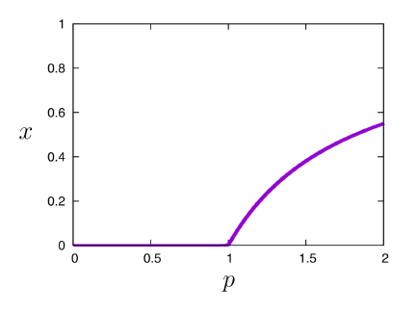
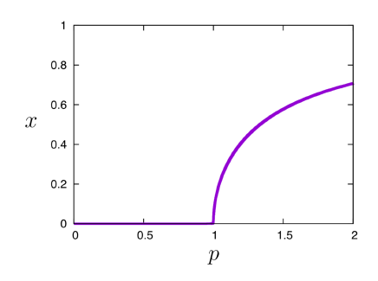
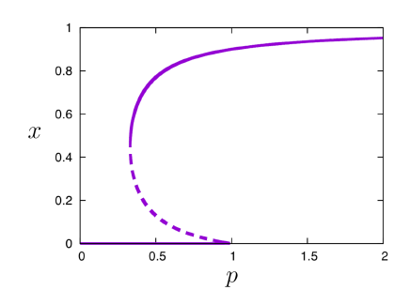
◆ The “thermodynamic limit” of the ant equation:
◆ Solving the equilibrium condition , we can find the solutions:
(Many ants leave the trail)
(Less ants leave the trail)
◆ When the pheromone become stronger, there is a sudden phase transition
◆ There are three possible patterns depending on a value of the parameter

Slide 9
(Less ants leave the trail)
◆ In this case, we have “a first order phase transition”.
◆ The dotted line is an unstable solution.
Under perturbations, it flows to the solid lines.
・ On the dotted line, by adding some ants to the trail
by hand, more and more ants will join the trail.
Then, the system goes to the upper solid line
Adding ants
a little bit
・ Similarly, by removing some ants from the trail,
the system goes to the lower solid line
Removing ants
a little bit
Existence of three saddles at intermediate p
comes from a subtle balance between the
attractive/repulsive forces of ants

Slide 10
Nest
pheromone
◆ Summary so far
・ The ant equation: a many-body system with a positive feedback
・ There are three kinds of behaviors
・ In particular, there is “a first order transition” when the positive feedback is very strong

Slide 11
2. Black holes in string theory

Slide 12
◆ Reading the paper of ants, Hanada-san got excited.
“Oh, this is very similar to systems with D-branes in string theory!”
◆ D-branes are fundamental objects in string theory. [Polchinski]
・ D0-branes ⇔ particles
・ D1-branes ⇔ strings
・ D2-branes ⇔ membranes
・ D3-branes ⇔ 1+3 dim objects, and so on
D-brane
Open string
◆ D-branes interact with each other through open strings
D-brane
◆ D-branes have an interaction with a positive feedback
Open strings
Another D-brane
The larger is , the more strongly
the bound state attracts the other D-brane,
because there are open strings in between.
A bound state of D-branes

Slide 13
◆ When the energy of D-branes is very high, they form a black hole, because string theory contains gravity.
◆ The following diagram is known for the type IIB superstring theory on AdS5xS5 at finite temperature
Internal energy
Large AdS black hole
◆ This is the Hawking-Page transition
(first order)
◆ The small black hole is unstable
having a negative specific heat
Small black hole
Very similar to ants!
・ Positive feedback
・ First order transition
・ Unstable saddle
Hagedron string
No black hole
Temperature

Slide 14
◆ The gauge/gravity correspondence [Maldacena]
Strong/Weak
duality
String theory
Gauge theory
(e.g. type IIB string on AdS₅)
(e.g. N=4 SYM on R×S³)
◆ Then, the similarity between string theory and ants will extend to gauge theories
Ants
String theory
Gauge theory
Similar
Equivalent
“Gauge theories should behave like ants!”
◆ In SU(N) gauge theories with adjoint matters, fields can be represented as N×N matrices.
Each matrix element couples to all the other elements, and this structure is the same as the D-branes.
Thus, the gauge theories will also have the positive feedback structure.

Slide 15
◆ The Hawking-Page transition ⇔ the confine/deconfine transition [Witten]
E
Large AdS black hole
In the dual SYM
Deconfined phase
Small black hole
What is the counter part?
Hagedron string
No black hole
Confined phase
T
◆ The unstable saddle is in between the confined and deconfined phases.
Then, it is natural to conjecture that this saddle is “a partially deconfined state”
in the gauge theory. [Hanada-Maltz, Berenstein]

Slide 16
◆ Partial deconfinement in large-N gauge theories?
for deconfined phase
＃(DOF)
for confined phase
What about the intermediate energy region such as ?
This case will correspond to states with
＃(DOF)
There will be the partial deconfinement
in the intermediate energy region.
Deconfined

Slide 17
◆ In the next (last) section, I will introduce the partially deconfined phase (PDP) in gauge theories.
◆ I will show that (1) PDP indeed exists for some gauge theories
(2) PDP can be either stable or unstable depending on a theory (or a parameter)
PDP
PDP
PDP
◆ This is in a nice analogy with the ant model:

Slide 18
3. Partial deconfinement

Slide 19
Confine/deconfine transition
◆ We mainly consider large-N SU(N) gauge theories with adjoint matters at finite temperature. (center sym)
◆ Polyakov loop
phase
distribution
◆ Polyakov loop is a good order parameter for the confine/deconfine transition
Deconfined
phase
Confined
phase
Flat in confined phase
Nonuniform in deconfined phase

Slide 20
◆ Partially deconfined phase (PDP)
Suppose that there exists another phase in between the confined and deconfined phases.
Deconfined
Another
phase
Phase transitions
Confined
It is natural to call it PDP, if the phase distribution takes the following form
i.e. D. O. F for SU(M) subgroup are already deconfined but the rest is still confined

Slide 21
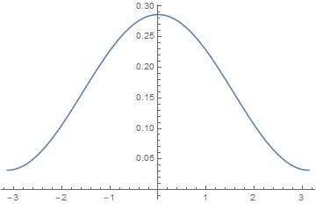
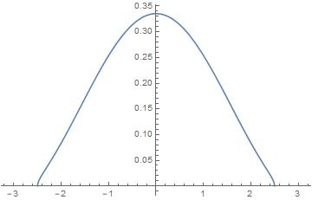
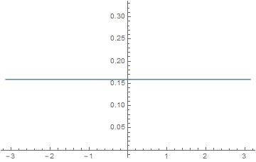
◆ Phase distributions in various phases
Confined phase
PDP
Deconfined phase
Uniform
Non-uniform
Gapless
Non-uniform
Gapped

Slide 22
◆ Relation to the Gross-Witten-Wadia (GWW) transition
GWW transition : a third order phase transition in 2D lattice pure YM.
In all the examples we considered, the phase transition from PDP to
the deconfined phase has the same structure as the GWW transition
PDP
Deconfined phase
These functional form and the order of transition coincide with those of GWW.
It is suggested that GWW’s structure is a universal feature of PDP.

Slide 23
◆ Example 1: N=4 SYM on S¹×S³
[Sundborg, Aharony et. al.]
Weak coupling limit (1-loop approx)
On the vertical orange line, we have
where parametrizes the orange line and
at the upper edge
at the lower edge
This satisfy the condition for PDP:
Identification

Slide 24
◆ From weak to strong coupling
Weak coupling limit
(1-loop approximation)
Strong coupling limit
(assuming gauge/gravity)
・
PDP
In N=4 SYM at finite coupling, PDP seems to be always unstable.
(⇔ small BH is always unstable in string theory)

Slide 25
◆ Example 2: Other gauge theories on S¹×S³ with adjoint matters
Weak coupling analysis
[Aharony et. al.]
Depending on matter contents, there are three patterns
For the left and center cases, the condition for PDP is satisfied
◆ Example 3: Free vector model
PDP condition holds

Slide 26
◆ Example 3 : Matrix quantum mechanics
Hermitian matrices
◆ This model has the following phase structure:
PDP
Modified
More data
Larger N
[Kawahara-Nishimura-Takeuchi, 2007]
[see Enrico’s poster]
We studied this case numerically
PDP condition satisfied

Slide 27
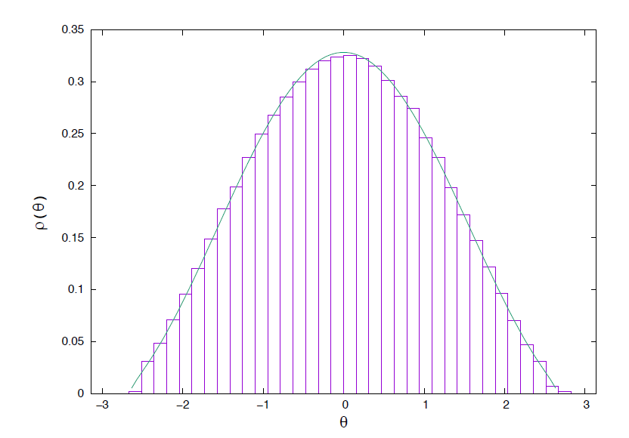
◆ We numerically computed near
・
◆ We find that can be fitted well by the GWW form.
Suggesting the universality
of GWW and existence of
unstable PDP saddle
Fitting function (GWW form)
with

Slide 28
Conclusion
Ants behave like gauge theories and vise versa
◆ We found a qualitative similarity between ants/strings/gauge theories.
Positive feedbacks, phase transitions, emergence of unstable saddles etc.
◆ We characterized PDP for gauge theories in terms of Polyakov loop phases
◆ PDP can be either stable/unstable depending on a theory or a parameter
Outlook
◆ We found some examples where PDP indeed exists. They all have GWW’s structure.
◆ Partial deconfinement may be a generic feature for theories with positive feedback
◆ How universal is PDP? It should also be studied for finite N, fundamental matters, and so on
◆ It would be interesting if PDP exists for QCD (even in an approximate sense)
cf. QCD at finite density: Cross over at and 1st order at
◆ We would like to study the correspondence between PDP and small Schwarzschild black holes.

