Slide 1
KEK / J-PARC Summer Student 2019 Kanlayaporn Kongmali (Oom) Chiang Mai University, Thailand Professor Ryukou Kato Associate Professor Kimichika Tsuchiya

Slide 2
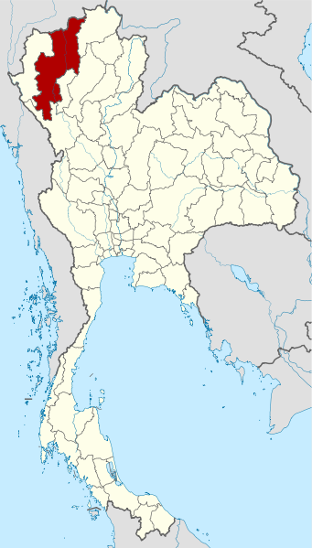
Location : northern of Thailand
Chiang Mai
Wikipedia Thailand Chiang Mai locator map

Slide 3
Department of Physics and Materials Science
Page: @PhysicsCMU

Slide 4
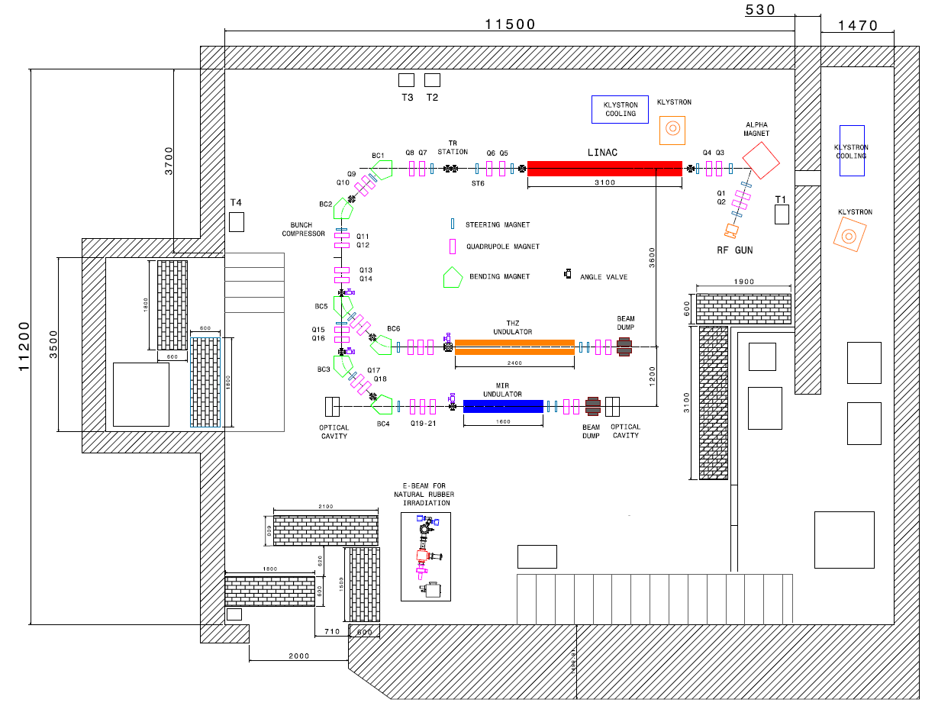
PBP Laboratory : New beamlines
Postdoc :Sikharin

Slide 5
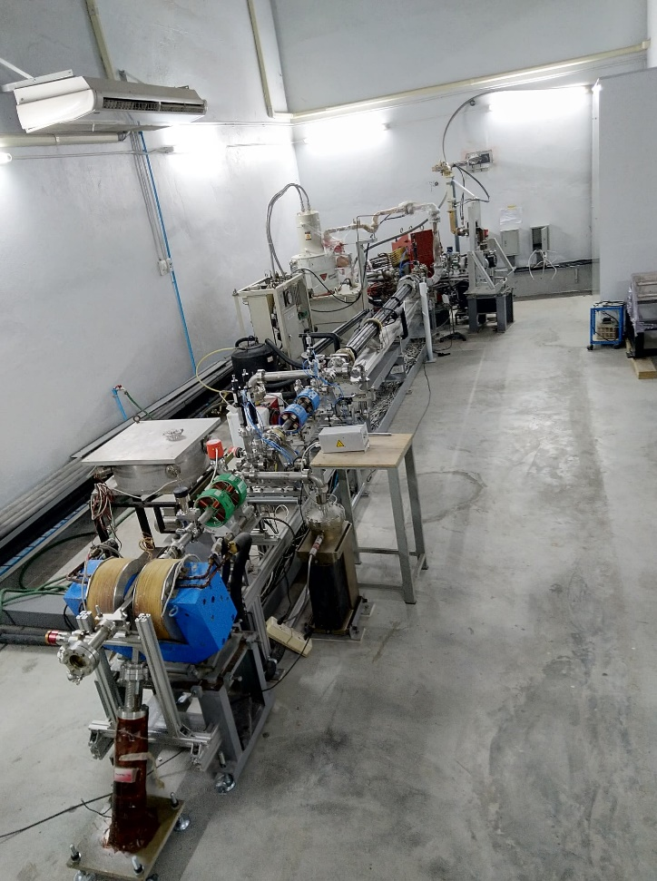
Postdoc :Sikharin

Slide 6
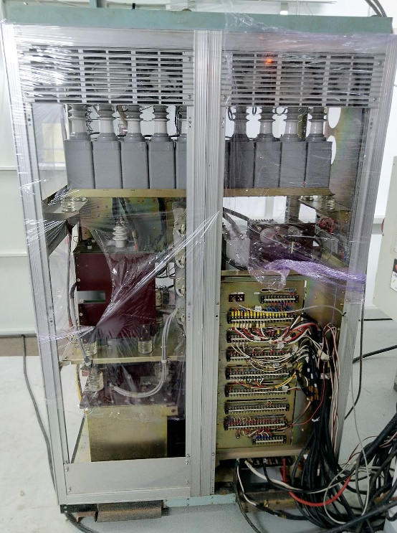
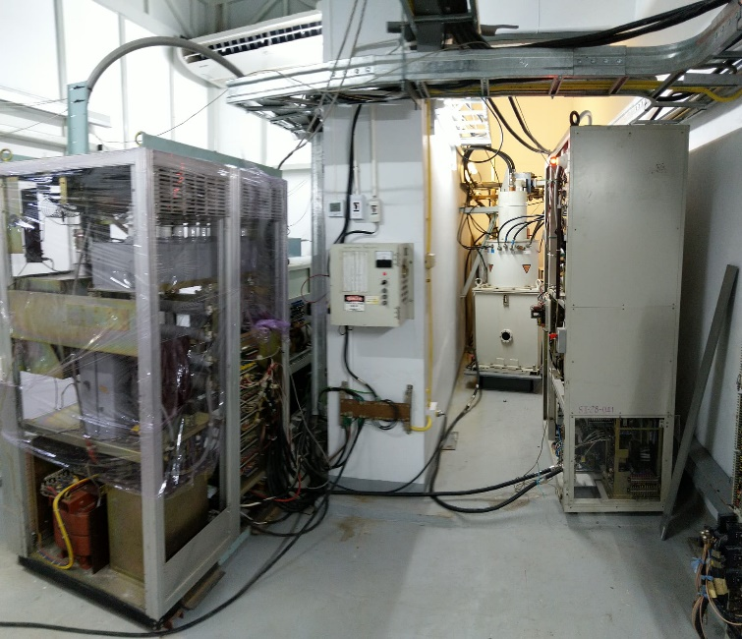
Postdoc :Sikharin

Slide 7
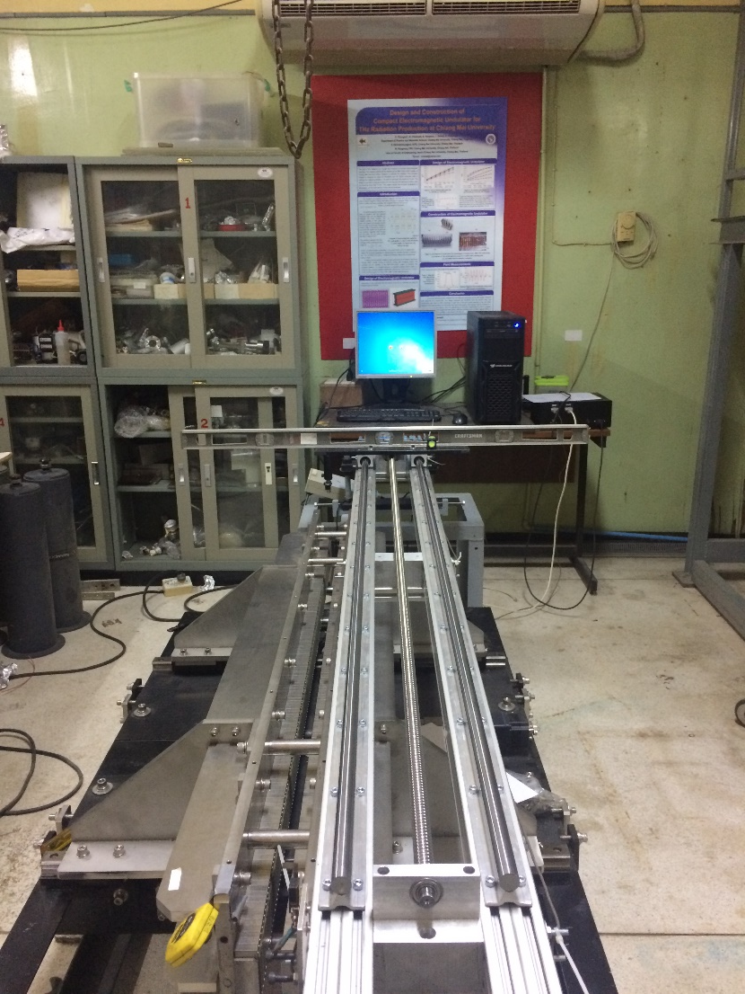
Previous work : undulator
Postdoc :Sikharin

Slide 8
KEK internship
Professor Ryukou Kato
- resonator simulation
Associate Professor Kimichika Tsuchiya
- Insertion device

